Slide 1
Grief Coach Training
Week 5 March 22, 2022

Slide 2
Agenda:
Coaching on coping skills
Increasing awareness
Understanding relationship challenges
Coaching on relationships

Slide 3
Cope
Understand
Discover
Resolve
Rebuild
HOPE Model of Healing
5 Foundations of Growth

Slide 4
Coping Skills
Most people aren’t fully aware of why they are doing the destructive behaviors they are doing
Although most people will have the thought that they shouldn’t be doing it

Slide 5
5 Foundations of Growth: Coping
Numbing
Awareness
Overeating
Overspending
Alcohol/Drugs
Music
Journaling
Walking

Slide 6
Awareness
Always the first step
Will create shifts
Has the potential of creating more shame
Leads to freedom of choice
Choice
Awareness
Unaware

Slide 7
“I should be doing better” Syndrome
Wants to make huge shifts
White knuckling to prove themselves
Forced “healing”
Shame

Slide 8
“I should be doing better” Syndrome
Validate where they are
Validate the way they have chosen to cope up until now
Encourage small steps towards improvement
Shame

Slide 9
With the wall of shame removed or reduced they are encouraged to make incremental progress.
Progress

Slide 10
Encourage self compassion, curiosity and life as an experiment
Progress

Slide 11
Temporary Relief Distractions
Overeating
Over shopping
Overworking
Inappropriate humor
Excessive TV/Movies
Fiction/Fantasy
Isolation
Sex
Oversleeping
Electronics – phone, tablets, computers, etc.
Drugs

Slide 12
Other Temporary Relief Distractions
Blaming

Slide 13
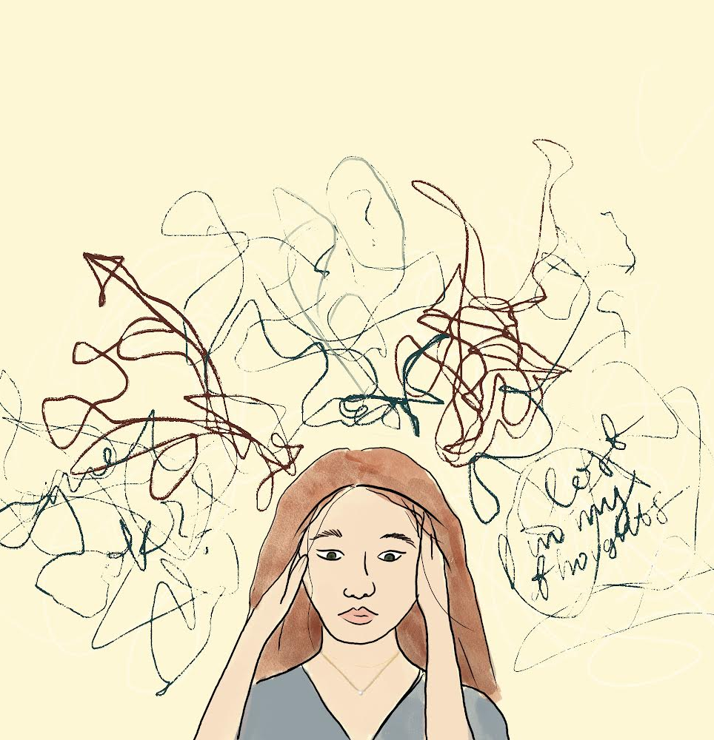
Other Temporary Relief Distractions
Blaming
Ruminating

Slide 14
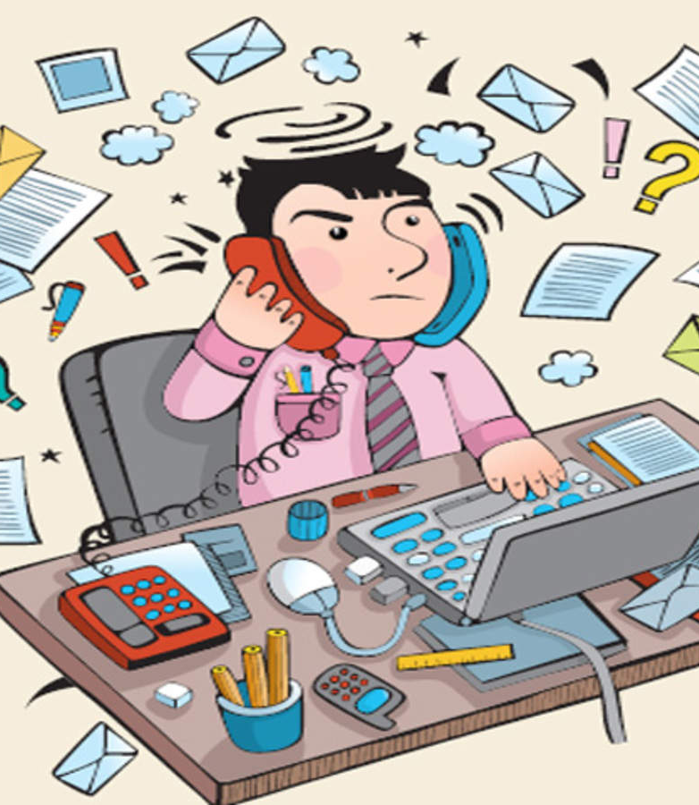
We live in a world with so many distractions that we never have to feel. As a result, awareness is low.

Slide 15
Introducing Temporary Relief
Distractions for what they are creates awareness.
Awareness is not always comfortable.

Slide 16
Healing coping activities
EFT or tapping
Write and rip
Music
Screaming into a pillow
praying
Journal
Draw
Take a class
Enjoy a hobby
What’s good for your body is good for your grief healing
Drink more water
Exercise
Ride a bike
Take a walk
Eat veggies and fruit

Slide 17
Invite them to do healing activities with intention.
Napping can be a good way to heal but if they nap with the thought that they’re not doing it right, they will create more heavy emotion instead of creating healing.
Crying can be an excellent release but if they have heavy judgment about their crying it won’t be as healing.

Slide 18
Improving Coping Skills
Invite them to slowly introduce new activities
Make incremental changes
Remind them that small steps are more sustainable than big leaps
Help them connect to how these changes are benefitting them
Celebrate the small changes with them

Slide 19
5 Foundations of Growth: Coping
Numbing
Awareness
Overeating
Overspending
Alcohol/Drugs
Music
Journaling
Walking

Slide 20
Awareness
Unaware
Awareness
Desire Change
Interrupt Pattern
Create Desired Change

Slide 21
Awareness
Unaware
Awareness
Desire Change
Interrupt Pattern
Create Desired Change

Slide 22
Interrupt Pattern
After
During
Before

Slide 23
Awareness is the first step to meaningful change.
Unaware
Awareness
Desire Change
Interrupt Pattern
Create Desired Change

Slide 24
Accepting your present reality doesn’t mean you endorse it. You may not like what is here but by meeting the truth of this moment with honesty and openness you develop more clarity on how to best move forward. Acceptance is the first step towards wise action. – Cory Muscara

Slide 25
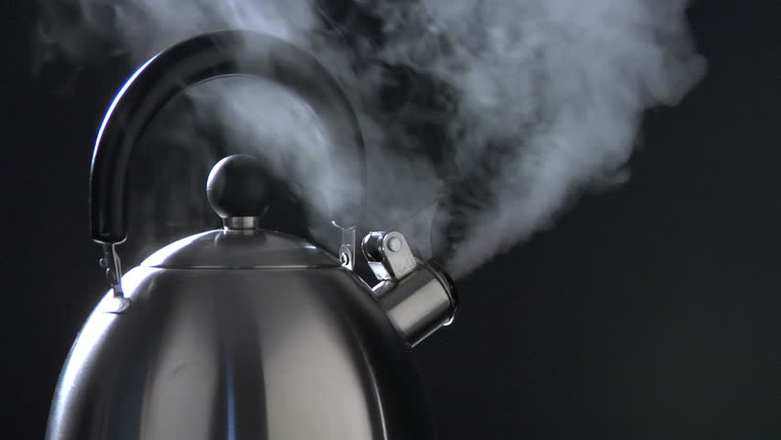
When was the last time you felt this build up in yourself?
Like you were going to explode.
What happened? What triggered it? What were you feeling? What were you thinking?
You can literally learn a process to understand your triggers that will lead to disarming the trigger.
Relationship Challenges

Slide 26
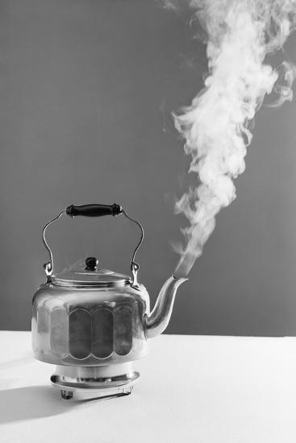
Thought Trigger
Image Trigger
Word Trigger

Slide 27
Thought Trigger
Image Trigger
Unaware
Word Trigger

Slide 28
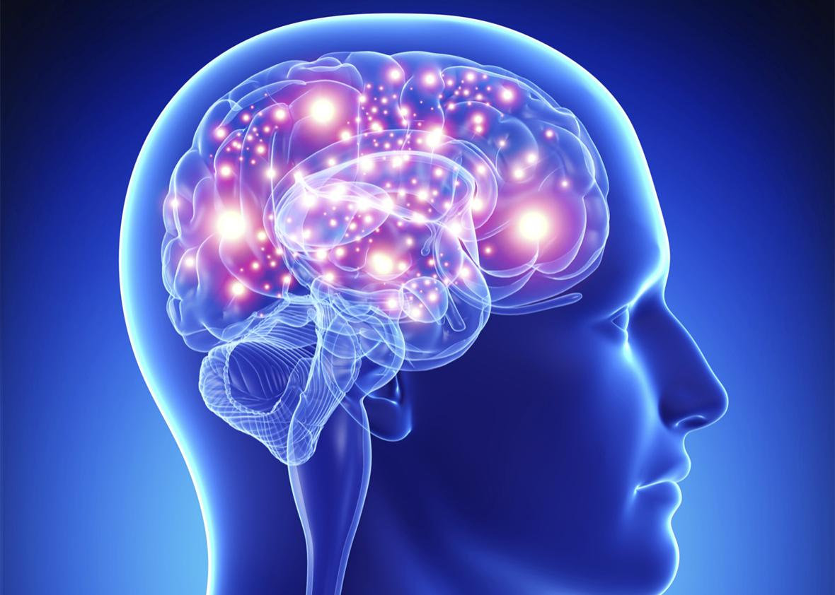
Our mind and our heart matter, in our grieving process

Slide 29
Thoughts
Relationships exist in our thoughts.
Results
Emotions
Actions

Slide 30
In grief:
Thoughts and emotions become intertwined.
Reactions are so immediate they don’t even think about it.
They learn practiced thoughts, feelings & behaviors.
Thoughts
Emotions
Actions
Results

Slide 31
Thoughts and emotions become intertwine
Reaction is so fast we don’t even think about it
We learn practiced, thoughts, feels & behaviors
I’ll be opening up for questions in a few minutes.
You can type them in the chat as we go
Thoughts
Thoughts and emotions become intertwine
Reaction is so fast we don’t even think about it
They learn practiced, thoughts, feels & behaviors
Grief Response
Results
Emotions
Actions

Slide 32
“Between stimulus and response there is a space. In that space is our power to choose our response. In our response lies our growth and our freedom.” – Viktor Frankl
As their coach, you create the space for them to see things differently, change their thinking and change their emotions, which changes their actions and results.
Stimulus:
Thought:
Emotion:
Action:
Result:

Slide 33
As their coach, you create the space for them to see things differently, change their thinking and change their emotions, which changes their actions and results.
Stimulus: friend didn’t call
Thought: no one cares about me
Emotion: lonely, abandoned, unloved
Action: feel sorry for yourself, isolate
Result: live isolated, depressed and lonely

Slide 34
As their coach, you create the space for them to see things differently, change their thinking and change their emotions, which changes their actions and results.
Stimulus: friend didn’t call
Thought: no one cares about me
Emotion: lonely, abandoned, unloved
Action: feel sorry for yourself, isolate
Result: live isolated, depressed and lonely
This thought is a grief response

Slide 35
As their coach, you create the space for them to see things differently, change their thinking and change their emotions, which changes their actions and results.
Stimulus: friend didn’t call
Thought: no one cares about me
Emotion: lonely, abandoned, unloved
Action: feel sorry for yourself, isolate
Result: live isolated, depressed and lonely
What else could be true?

Slide 36
As their coach, you create the space for them to see things differently, change their thinking and change their emotions, which changes their actions and results.
Stimulus: friend didn’t call
Thought: I love her, and I want to stay
connected.
Emotion: love, thankful, connected
Action: call your friend, stay connected, create bond
Result: friendship and connection
What else could be true?

Slide 37
Next meeting:
Tuesday, April 5th
Chapters 6

Slide 38
Brain
heart
Past
Future

Slide 39
Brain
heart
Brain
heart
Past
Future

Slide 40
“A memory without the emotional charge is called wisdom.”
– Dr. Joe Dispenza
Past
Future

Slide 42
Agenda
3 prerequisites: Desire, Hope and Effort
The Hope Model of Healing
Transcending the Levels of Consciousness
Post-traumatic growth
Understanding relationship challenges

Slide 43
Desire
Results
Behavior

Slide 44
Blocks to Desire
Lack of Hope; Despair
Rewards of Grieving
Learned Hopelessness

Slide 45
3 Aspects of Motivation
Clear and compelling goal
A path to get there
Confidence that they can actually do it

Slide 46
Hope
Hope
Influenced by their thoughts
Influenced by what they consume
Influenced by what others are saying
Help them see how their choices influence their results
Help them choose what they think, what they consume and what they believe
Despair

Slide 47
Effort
"If time actually healed people, no one in the world would be hurting. Time is simply space. What matters is how you use it. If you fill your time intentionally with self-love, letting go, and building the new habits your being needs, that would make a real difference" -Yung Pueblo
Understanding and applying the steps of healing gives people their power back. Then they experience fruitful effort.

Slide 48
Cope
Understand
Discover
Resolve
Rebuild
HOPE Model of Healing
5 Foundations of Growth

Slide 49
Cope
Understand
Discover
Resolve
Rebuild
HOPE Model of Healing
5 Foundations of Growth

Slide 50
Cope
Understand
Discover
Resolve
Rebuild
HOPE Model of Healing
5 Foundations of Growth

Slide 51
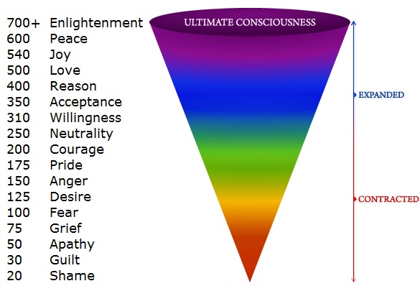

Slide 52
Grief
This is the level of sadness, loss and despondency. Most people have experienced it for periods of time, but those who remain at this level live a life of constant regret and depression.
This is the level of mourning, bereavement and remorse about the past.
Major losses in early life make one later vulnerable to passive acceptance of grief, as though sorrow were the price of life.
This level colors one’s entire vision of existence. Part of the syndrome of loss is the sense of inability to replace what is lost or what is symbolized.

Slide 53
Clinical
The universality of the experience is due to the structure and nature of the ego, which misperceives the source of happiness as external or emotional and imbues it with specialness. In reality, the only source of happiness is from within.
The spiritually evolved person who has few wants or attachments is relatively immune to grief, as the experience of the source of happiness originates from within and is not dependent on externals.
Happiness is the inner psychological reward for achievement of externalized goals as a self-reward system, and the error is to think that the source of happiness is due to the ‘out there’ instead of originating from within.
The externalization of perceived sources of happiness leads to attachments and the emergence of control as a major survival mechanism, along with the desire for status and its symbols of security, and therefore, materialism.

Slide 54
Spiritual Orientation
Not uncommonly, major loss results in turning to religion or spirituality for help and answers. Loss therefore provides an opportunity for increased intention to reevaluate spiritual principles and put them into actual practice rather than just intellectual appreciation.
It is well to know that spiritual research indicates that all suffering and emotional pain result from resistance. Its cure is via surrender and acceptance, which relieve the pain.
Pain of loss is not steady or continuous but comes in waves that can be diminished by consistent nonresistance and surrendering continuously to God.
Paradoxically, loss is simultaneously freedom and opening of new options. Loss services inner adaptations and qualities that represent opportunities for growth.
All aspects of human life are transient; therefore, to cling to any aspect eventually brings grief and loss.
Grief and loss, like any stressful situation in life, can be seen as a valuable growth opportunity and a time for reassessment of values and goals.

Slide 55
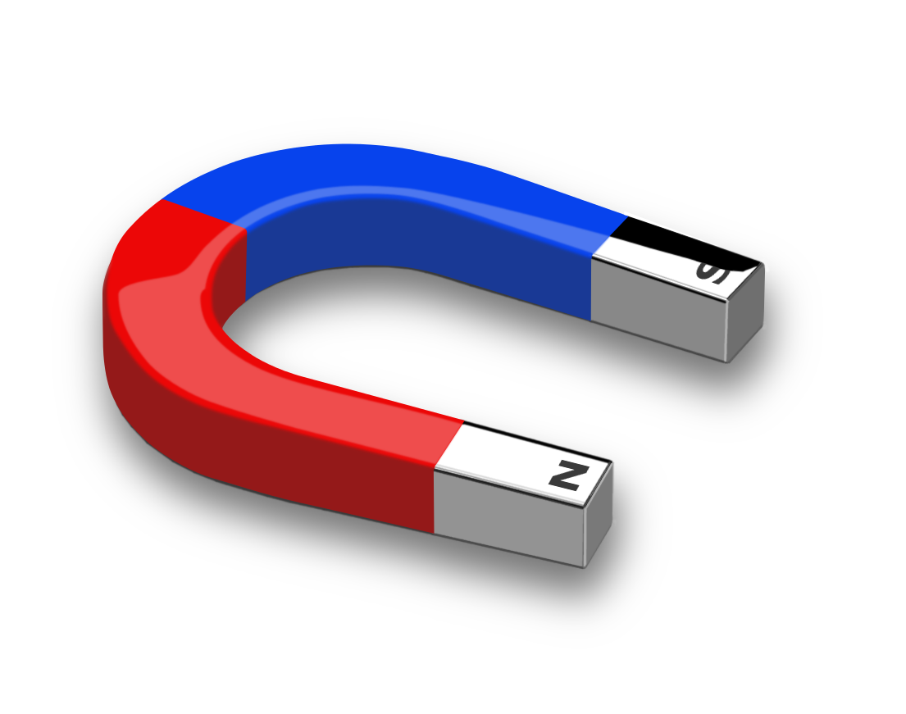
Dualities of Grief
Attraction Aversion
Cling to → Let go of
Live in the past → Live in the now
Undo → Accept
Bargain with God → Accept limitation
Deny → Work through
Anger, resentment → Acceptance
Resist → Transcend
Despondency → Hope
Go back in time → Move forward
Life full of problems → Life full of solutions
Bitter → Faith and hope

Slide 56
Post-traumatic Growth
Attraction Aversion
Cling to → Let go of
Live in the past → Live in the now
Undo → Accept
Bargain with God → Accept limitation
Deny → Work through
Anger, resentment → Acceptance
Resist → Transcend
Despondency → Hope
Go back in time → Move forward
Life full of problems → Life full of solutions
Bitter → Faith and hope

Slide 57
“Post-traumatic growth describes the positive life changes that develop through a stressful, frightening experience.
“Researchers note that post-traumatic growth is not the same as resilience. Resilience describes people returning to their previous levels of functioning. Meanwhile, post-traumatic growth refers to positive personal change.
“Studies show that after a traumatic event, reports of personal growth are more common than those of psychiatric disorders.”
(cancer.net)

Slide 58
It’s comforting to know that post traumatic growth is much more likely than posttraumatic stress. In an article by Lorna Collier for the American Psychological Association she wrote:
“Post-traumatic growth (PTG) is a theory that explains this kind of transformation following trauma. It was developed by psychologists Richard Tedeschi, PhD, and Lawrence Calhoun, PhD, in the mid-1990s, and holds that people who endure psychological struggle following adversity can often see positive growth afterward.’
“People develop new understandings of themselves, the world they live in, how to relate to other people, the kind of future they might have and a better understanding of how to live life,’ says Tedeschi.”

Slide 59
Growth developed after loss:
new understandings of themselves
new understandings of the world they live in
how to relate to other people
the kind of future they might have
better understanding of how to live life

Slide 60
Next meeting:
Tuesday, March 22nd
Chapters 5

Slide 62
Agenda:
Healing vs. Despair
Levels of Grief
Grief/Trauma Response
Capacity during Grief
Restorative Self Care

Slide 63
Healing
Peace
Joy
Love
Grief is a normal response to loss. It also places someone at the crossroad between despair and healing.
Grief is intended to support healing but it’s dangerously close to despair.
Grief is a season.
Courage
The choices made regarding thoughts, feelings and actions, while in grief, matter.
Courage is on the path to healing.
Grief
Guilt
Fear
Shame
Despair

Slide 64
Your Grief

Slide 65
Model of Grief

Slide 66
Model of Grief
Hidden Grief
Prolonged Anger
Victim Mentality
Hopelessness

Slide 67
Hidden or Unresolved Grief
Grief
Happiness
Goals & Desires

Slide 68
Level 1: Resolved Grief
Behaviors:
Hobbies/Interests
Self Care
Comfortable Talking about Your Loss
Social
Build Relationships
Live a Full Life with a Full Range of Emotions
Common Emotions:
Happiness
Purpose
Occasional sadness

Slide 70
Thoughts and emotions become intertwine
Reaction is so fast we don’t even think about it
We learn practiced, thoughts, feels & behaviors
I’ll be opening up for questions in a few minutes.
You can type them in the chat as we go
Thoughts
Results
Emotions
Actions

Slide 71
Thoughts and emotions become intertwine
Reaction is so fast we don’t even think about it
We learn practiced, thoughts, feels & behaviors
I’ll be opening up for questions in a few minutes.
You can type them in the chat as we go
Thoughts
Grief Response
Results
Emotions
Actions

Slide 72
Thoughts and emotions become intertwine
Reaction is so fast we don’t even think about it
We learn practiced, thoughts, feels & behaviors
I’ll be opening up for questions in a few minutes.
You can type them in the chat as we go
Thoughts
Grief Response
Results
Emotions
Actions

Slide 73
Thoughts and emotions become intertwine
Reaction is so fast we don’t even think about it
We learn practiced, thoughts, feels & behaviors
I’ll be opening up for questions in a few minutes.
You can type them in the chat as we go
Thoughts
Grief Response
Results
Emotions
Actions

Slide 74
Thoughts and emotions become intertwine
Reaction is so fast we don’t even think about it
We learn practiced, thoughts, feels & behaviors
I’ll be opening up for questions in a few minutes.
You can type them in the chat as we go
Thoughts
Grief Response
Results
Emotions
Actions

Slide 75
Trauma:
A deeply distressing or disturbing experience
physical injury.

Slide 76
Expanded definition:
Trauma is anything that causes someone to feel less than, small, unworthy or unlovable.

Slide 77
When someone practices thoughts that they’re not good enough, less than or aren’t lovable, they suppress their life force energy and their ability to heal.

Slide 78
Unhealed trauma/grief can cause someone to not live out the true expression of who they are.
Labels and statistics may be holding them back.
Trauma

Slide 79
The Grief Recovery Handbook…
-defines trauma as ongoing mistreatment or abuse that a person may experience
-or the impact of a singular event
-suggests that labeling losses as Trauma and PTSD moves you away from recovery.

Slide 80
Identifying the loss so that it can be worked on moves them toward healing.
What is the loss?
Loss of trust
Loss of safety
Loss of control
Loss of value
Trauma

Slide 81
Capacity
Grief

Slide 82
The problem isn’t grief.
Grief is the solution.
The problem is the misunderstanding and judgment of grief.

Slide 84
Capacity
Grief:
Guilt
Fear
Shame
Etc.

Slide 85
Capacity
Fear
Shame
Guilt
Grief

Slide 86
Capacity
Fear
Shame
Guilt
Grief

Slide 87
Restorative Self Care
Restorative - having the ability to restore health, strength, or a feeling of well-being
Restorative self care is care for the self that has the ability to restore (repair) health, strength and a feeling of well-being

Slide 88
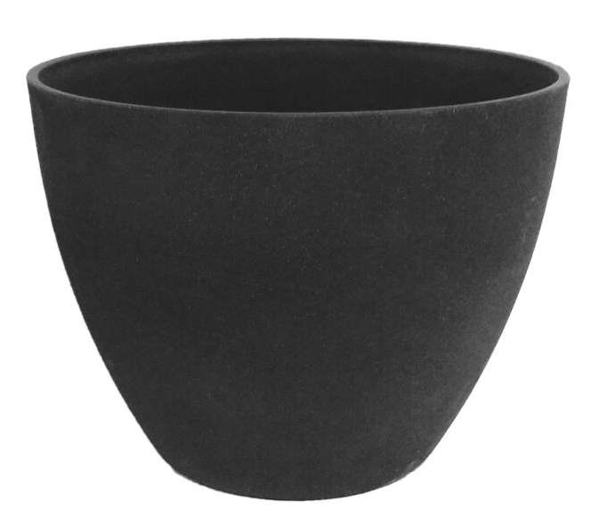
Guilt
Shame
Fear
Sadness
Pain
Grief

Slide 89
Love
Compassion
Gratitude
Restorative
Process
Sadness
Pain
Grief

Slide 90
Feeling
Walking
Nature
Breathing
Meditation
Uplifting Music
Journaling
Restorative
Process
Accept your emotions/energy
Do the things you enjoy
Create a compassionate inner dialog
Allow emotions
Breathe
Advocate for yourself
Take breaks when you need to
Overeating
Overdrinking
Netflix Binging
Social Media
Over shopping
Over sleeping
Anger

Slide 91
Restorative Self Care
Through a regular practice of releasing heavy emotion and inputting the good, with time and effort, capacity can be restored and even expanded.
They can exercise their power of personal choice by choosing the daily practice of releasing emotion.
In this way they gently take responsibility for their experience.
Capacity
Fear
Shame
Guilt
Grief

Slide 92
Restorative Self Care
Through a regular practice of releasing heavy emotion and inputting the good, with time and effort, capacity can be restored and even expanded.
They can exercise their power of personal choice by choosing the daily practice of releasing emotion.
In this way they gently take responsibility for their experience.
Over time and as they work through the Hope Model of Healing, they’ll start to feel relief from grief.
Because we’re human we will always experience a range of emotions.
Capacity
Fear
Shame
Guilt
Grief

Slide 93
Restorative Self Care
Through a regular practice of releasing heavy emotion and inputting the good, with time and effort, capacity can be restored and even expanded.
They can exercise their power of personal choice by choosing the daily practice of releasing emotion.
In this way they gently take responsibility for their experience.
Over time and as you work through the Hope Model of Healing, you’ll start to feel relief from grief.
Because you’re human you will always experience a range of emotions.
Yet having released heavy grief they can restore their capacity again.
Regardless of their capacity they are always whole and worthy.
Over time and as they work through the Hope Model of Healing, they’ll start to feel relief from grief.
Because we’re human we will always experience a range of emotions.
Capacity

Slide 94
Next meeting:
Tuesday, March 8th
Chapters 3 & 4

Slide 97
Goal:
to become…
Comfortable
Confident
Effective
in supporting a client in their grief and assisting them in incremental healing steps and shifts.

Slide 98
What is loss?
death, divorce, ill health, relationship
difficulty, break up, miscarriage,
still birth, pet loss, financial loss, estrangement, abuse, etc.
All loss causes feelings of grief.

Slide 99
What is Grief?
Traditional definition: deep sorrow,
especially that caused by someone’s
death.

Slide 100
What is Grief?
Expanded definition:
The unrelenting painful feelings caused by emotional injury or loss of any kind. The painful feelings of loss of a desired future or outcome.

Slide 101
What is Healing?
The release of unrelenting painful feelings.
Experiencing feelings of purpose, happiness and enthusiasm for life.
Feeling occasional sadness about your loss.
Being comfortable talking about your loss.
Living a full life with a full range of emotions.

Slide 102
Coaching Package
12 appointments
1st appointment: Assessment
Grief
Confidence
Relationships
Health
Purpose
Each appointment review a new chapter/assignment

Slide 103
Weekly Appointment
What Went Well this Week? (WWW)
Anchor in WWW
What Didn’t Go Well? (WDW)
Find the lessons in the WDW
What stood out in your reading?
Discover what is important to them and what is shifting
What questions do you have?
Discover where they are struggling
What are you ready to shift?
Find their concerns
What are your take aways
Anchor in the things they learned
Use Session Prep Form

Slide 104
The Power of a Good Question
Use for Discovery
Expand Understanding
Create Space for Shifts

Slide 105
The Power of a Good Question
What?
What happened?
What did you think? Feel? Do?
When?
Where?
How?
How did you feel?
How did you respond?

Slide 106
The Power of a Good Question
Why?
Use sparingly
Why did you choose to think/feel that? Why do you think/feel this happened/ she did this?
What if?
What if it’s ok to be sad?
What if it’s possible to allow this?
What if you could let go of carrying this heavy burden?

Slide 107
Growing Around Grief

Slide 108
HOPE Model of Healing
When we have the strength to carry the grief, we have the strength to heal.

Slide 109
Grief
Healing

Slide 110
Have you experienced the heavy pull of grief?
Cope
Rebuild

Slide 111
Grief
Healing

Slide 112
Grief
Healing
Vision

Slide 113
Grief
Healing

Slide 114
HOPE Model of Healing
5 Foundations of Growth
REBUILDING
RESOLVING
DISCOVERING
UNDERSTANDING
COPING

Slide 115
The problem isn’t grief.
Grief is the solution.
The problem is the misunderstanding and judgment of grief.

Slide 116
Week 2 Assignments:
Read, study chapter 2
Answer the questions in the workbook

Slide 118
Grief is uncomfortable
Fear because you don’t know what to do
Feel helpless
Feel like you must fix it
Panic because you don’t understand grief
Anxious to talk people out of it
Goal: to become comfortable, confident and effective in supporting a client in their grief and assisting them in incremental steps and shifts.

Slide 119
“Nothing good has come from the death of my daughter, but good has come from my response to it.”
-Sandy

Slide 120
Why I’m Able to Do This Work
Because I know in my bones that healing is possible
Because I have felt the affects of grief healing and I’m encouraged to share that with others
Because if a person is willing to put in the effort, learn and grow they will experience healing

Slide 121
“The pain that you create now is always some form of nonacceptance, some form of unconscious resistance to what is.
“On the level of thought, the resistance is some form of judgment.
“On the emotional level, it is some form of negativity.
“The intensity of the pain depends on the degree of resistance to the present moment, and this in turn depends on how strongly you are identified with your mind.”
–Eckhart Tolle, The Power of Now, pg. 33

Slide 122
Levels of Consciousness

Slide 123
Common physical, emotional and social grief symptoms:
Crying
Headaches
Interruption in Sleep Patterns
Questioning the Purpose of Life
Questioning Your Spiritual/Religious Beliefs
Feelings of Detachment
Isolation from Friends and Family
Abnormal Behavior
Abnormal Thoughts
Worry
Anxiety
Frustration
Guilt
Fatigue
Anger
Change in Appetite
Aches and Pains
Stress

Slide 124
Common treatments:
Counseling
Medication
Support groups
Common attitudes:
Time Heals
Learn to Live With It

Slide 125
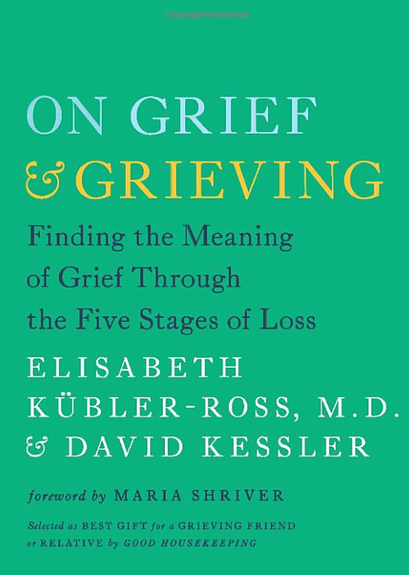
The History of Grief Education
1969 Dr. Elisabeth Kubler-Ross – 5 Stages of Grief, On Death and Dying
2005 Dr. Kubler-Ross with David Kessler, On Grief and Grieving
1996 Dr. Lois Tonkin Model of Grief

Slide 126
The History of Grief Education
“Limited literature on grief”
“I’ve never heard this before and I’m a social worker. I am filled with so much hope. People need to know about this.”

Slide 127
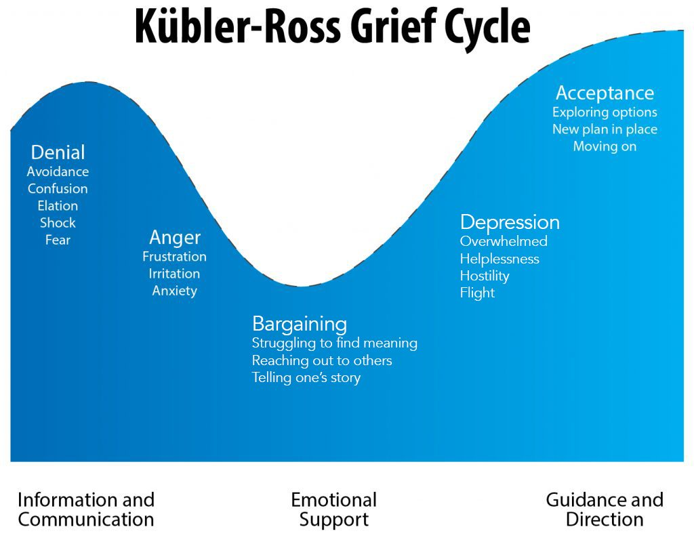

Slide 128
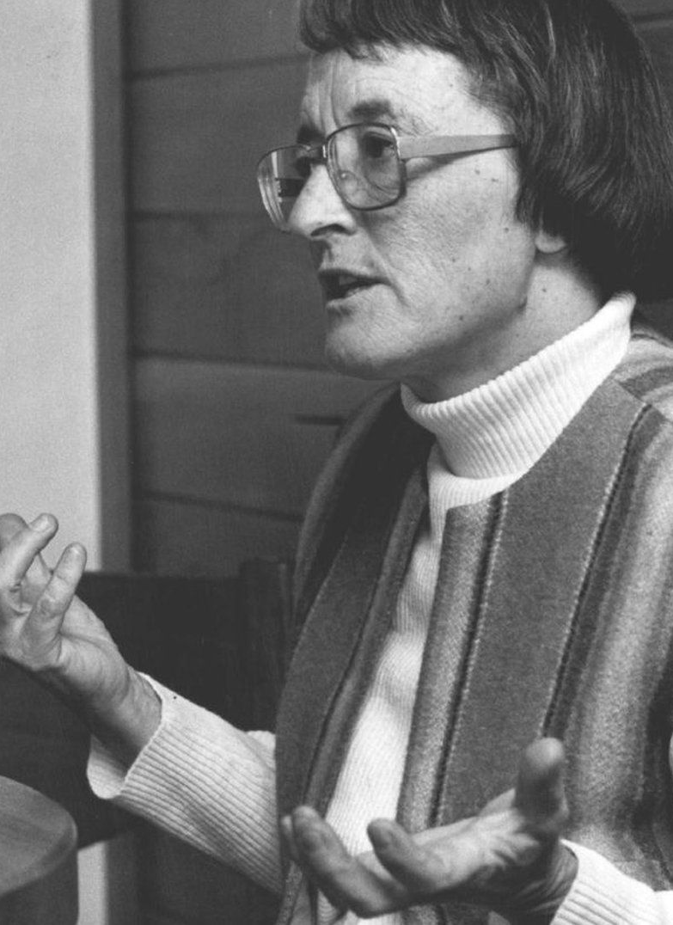
5 Stages of Grief
Denial, Anger, Bargaining, Depression and Acceptance
Developed by Dr. Elisabeth Kübler-Ross
Explains common emotional responses
Not linear as ‘stages’ suggest
Incomplete and doesn’t offer a pathway

Slide 129
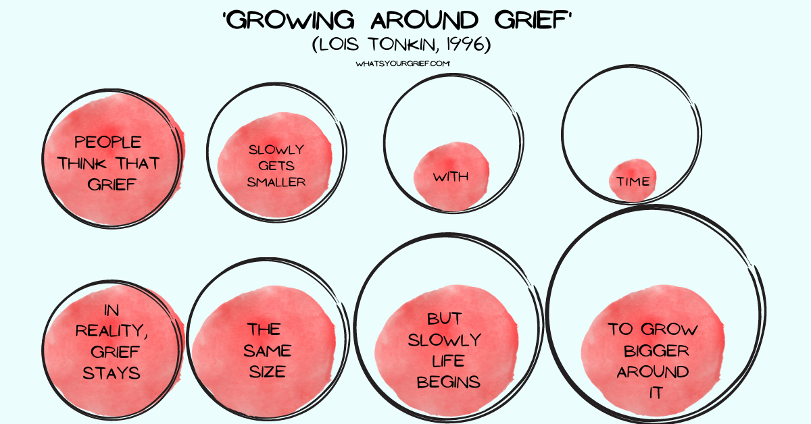
Model of Grief

Slide 130
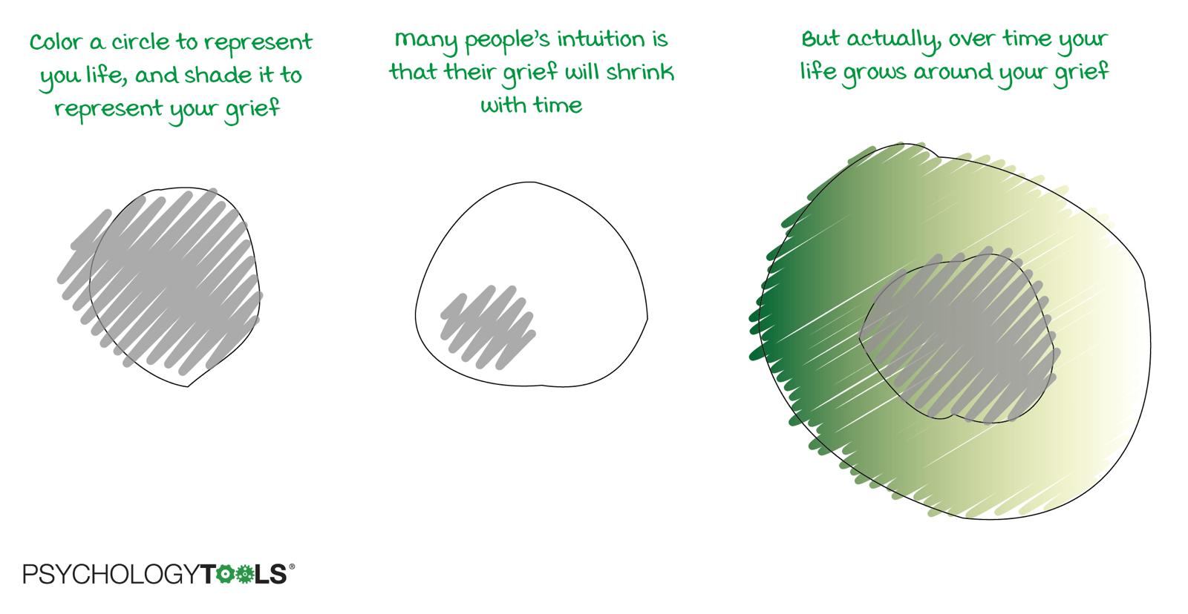
Model of Grief

Slide 131
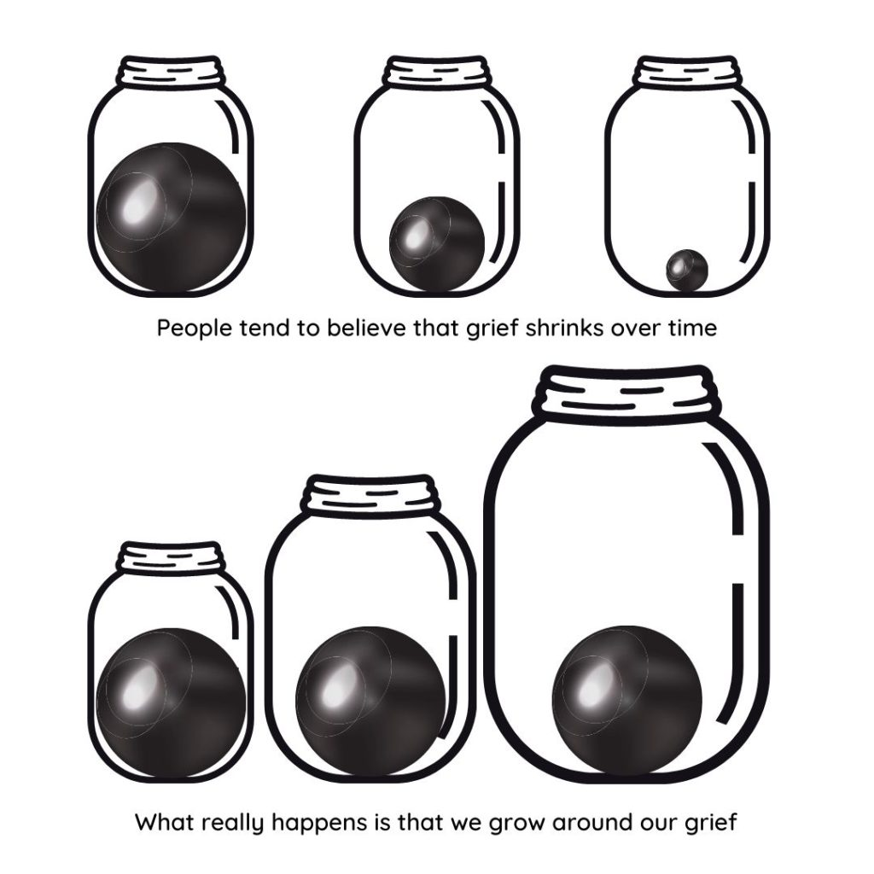
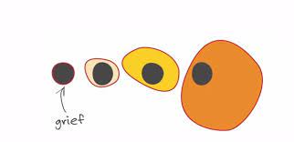
Model of Grief

Slide 132
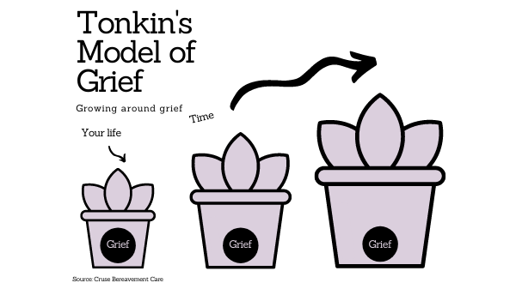
Model of Grief
https://fb.watch/b2xJ8GT8E7/

Slide 133
Model of Grief

Slide 134
HOPE Model of Healing
When we have the strength to carry the grief, we have the strength to heal.

Slide 135
HOPE Model of Healing
Honor Your Grief
Open to Understanding
Prepare through Discovery
Embrace Resolution and Rebuilding
HOPE offers a pathway to healing
and leads to transformation
©JULIE CLUFF buildalifeafterloss.com

Slide 136
Brain
heart
Past
Future

Slide 137
feelings and emotions are a record of the past
those feelings are driving your hardwired thoughts and behaviors…
-Dr. Joe Dispensa
Past
Future

Slide 138
Past
Future

Slide 139
Past
Future

Slide 140
Listen for shame.
“I should be doing better” is identity shame.
Shame says, “I am bad.”
Shame is a lower vibration than grief and blocks healing.
Shame

Slide 141
Lies make us weak.
The truth makes us stronger.
Gently direct client to truth.
Shame

Slide 142
Encourage empowering thoughts and gentle progress.
The truth is they are right where they are supposed to be.
The truth is they hurt and that’s ok.
The truth is the power to do is the power to change.
The truth is they can make progress.
The truth is progress is progress.
Progress

Slide 143
Do not underestimate the power of new thoughts/knowledge.
Do not underestimate the power of expression.
Progress

Slide 145
Post-traumatic Growth
A positive psychological change experienced as a result of adversity and other challenges in order to rise to a higher level of functioning.
Posttraumatic growth involves "life-changing" psychological shifts in thinking and relating to the world, that contribute to a personal process of change, that is deeply meaningful.

Slide 146
Week 1 Assignments:
Read intro and chapter 1
Underline things that stand out to you. Make note of any questions
Answer the questions in the workbook
On page 4 underline or list what I had to learn/shift to heal
Log into the True Hope Club
Listen to any of the webinars or podcast episodes you’re interested in

