Slide 1
Grief Coach Training
Week 9: April 26, 2022

Slide 2
Agenda:
Communications Chart
Letter
Hope Model of Healing
Business Strategies

Slide 3
Communications Chart
What was your biggest challenge with creating your chart?
What did you learn about yourself and your life experience from creating your chart?
What value did you gain from creating your chart?

Slide 4
Letter
What was your biggest challenge with writing your letter?
What did you learn about yourself and your life experience from writing your letter?
What value did you gain from writing your letter?

Slide 5
HOPE Model of Healing
5 Foundations of Growth
REBUILDING
RESOLVING
DISCOVERING
UNDERSTANDING
COPING

Slide 6
Business Strategies
Finding clients
Scheduling clients
Holding a Discovery Call (the consult)

Slide 7
Finding Clients
Show up regularly
Social media
Podcasting/Blogging
Speaking/Webinars
Emails
Website
Referrals & Testimonials

Slide 8
Scheduling Consults/Clients
Decide on appointment structure
Block off times for appointments
Use a scheduling app (Calendly $16/mo)

Slide 9
Discovery Call
How did you find me?
What prompted you to meet with me?
How long has this been going on?
What have you done about it?
What has worked?
What hasn’t worked?
If nothing changes, can you live with this for the rest of your life?
What do you want it to look like? How do you want things to change?
How can I help you?

Slide 10
Discovery Call
Can I share with you what it would look like to work with me?
Are you open to that time commitment?
Wait for them to ask for pricing
Answer directly, then be quiet
What are your thoughts or concerns about working together?
(I need to talk to my spouse/partner.) Besides talking to your spouse/partner, what are your concerns?
When you talk to your partner, what will you say? What do you think they’ll say?

Slide 11
Enrolling
If they say they need to think about it, set up a 10-minute appointment in a couple of days to follow up.
When they say yes, take their payment over the phone and set up their first appointment.
Payment method
contract
calendar

Slide 12
Enrolling
Subject: Coaching
Hi
So good to talk to you today. I’m really looking forward to working with you! It’s going to be amazing.
I’ve attached the form I talked to you about. Please fill it out, sign and return it via text or email with your payment before our first appointment
This is the payment link:
This is the zoom link: Save this link as this is where we’ll meet each time.
Talk to you soon.
Xoxo Julie

Slide 13
What’s Next
Set up appointment with me
Hold appointments with 3-5 practice clients

Slide 15
Personal Stories Timeline
What was your biggest challenge with creating your timeline?
What did you learn about yourself and your life experience from creating your timeline?
What value did you gain from creating your timeline?

Slide 16
Relationship Memories Graph/Map
What was your biggest challenge with creating your graph/map?
What did you learn about yourself and your life experience from creating your graph/map?
What value did you gain from creating your graph/map?

Slide 17
Coaching Timeline & Graph/Map
Before/During their share:
Inform them you’ll be silent while they share
Comments will change their flow and direction
Listen intently to their share

Slide 18
Coaching Timeline & Graph/Map
After their share:
Thank them for sharing
How did it feel to create the timeline/graph?
How did it feel to share your timeline/graph?

Slide 19
Communications Chart

Slide 20
Next meeting:
Tuesday, April 27th
Chapter 8 assignments
Communication Chart
Letter

Slide 23
Thoughts
Results
Emotions
Actions

Slide 24
Coaching on TTEAR (TFA cycle or TEAR)
Topic: neutral
Thought: influenced by past experiences/traumas and conditioning
Emotion: response to thoughts
Action: direct response to emotions
Result: created by actions and mirrors thoughts

Slide 25
TTEAR
Topic: friend says, you talk about your son too much
Thought: She doesn’t understand me. She doesn’t care.
Emotion: loneliness, sadness, misunderstood
Action: isolate, ignore friend, cry, blow up so that we think cares
Result: overall feeling no one cares, prolonged isolation
Topic: friend says, you talk about your son too much
Thought: She doesn’t understand and that’s ok.
Emotion: relief, compassion
Action: move forward, don’t overthink, acceptance,
Result: It is ok.

Slide 26
TTEAR
Topic:
Thought:
Emotion:
Action:
Result:
Topic:
Thought:
Emotion:
Action:
Result:

Slide 27
Coaching Package
12 appointments
50 minutes
Tuition: $1000 – $3000+
1st appointment: Assessment
Grief
Confidence
Relationships
Health
Purpose

Slide 28
Coaching Package
12 appointments
Week 1: Assessment, HW: ch 1
Week 2: HW: ch 2
Week 3: HW: ch 3
Week 4: HW: ch 4
Week 5: HW: ch 5
Week 6: HW: ch 6

Slide 29
Coaching Package
12 appointments
Week 7: HW: Ch 7, Personal Stories Timeline
Week 8: PST, HW: Ch 7, Relationship Memories Chart
Week 9: RMC, HW: Ch 8, Communications Chart
Week 10: CC, HW: Ch 8 Letter
Week 11: Letter, HW: Ch 9
Week 12: Wrap up

Slide 30
Weekly Appointment
What Went Well this Week? (WWW)
Anchor in WWW
What Didn’t Go Well? (WDW)
Find the lessons in the WDW
What stood out in your reading?
Discover what is important to them and what is shifting
What questions do you have?
Discover where they are struggling
What are you ready to shift?
Find their concerns
What are your take aways
Anchor in the things they learned
Use Session Prep Form

Slide 31
Business strategies
Holding a Discovery Call (the consult)
Finding clients
Scheduling clients

Slide 32
Assignments
Communications Chart
Letter of Forgiveness, Gratitude and Love

Slide 33
Next meeting:
Tuesday, April 19th
Chapter 7 assignments
832-515-4632

Slide 35
Grief Coach Training
Week 6: April 5, 2022

Slide 36
Agenda:
Boulder of Grief
Emotions
Vocabulary
Allowing
Guilt, Shame & Anger
Healing Resistance

Slide 37
HOPE Model of Healing
5 Foundations of Growth
REBUILDING
RESOLVING
DISCOVERING
UNDERSTANDING
COPING
©JULIE CLUFF buildalifeafterloss.com

Slide 38
Death of a child, spouse, parent, sibling, friend
Still birth
Miscarriage
Divorce
Break up
Estrangement
Abuse
Health crisis
Career/job loss
Boulder of Grief

Slide 39
Crushed
Devastated
Distressed
Shattered
Shocked
Overwhelmed
Distraught
Boulder of Grief

Slide 40
Boulder of Grief

Slide 41
Boulder of Grief

Slide 42
Death
Divorce
Abuse
Health crisis

Slide 43
Death
Divorce
Abuse
Health crisis

Slide 44
Death
Divorce
Abuse
Health crisis

Slide 46
“Just as thoughts are the language of the brain, feelings are the language of the body. And how you think and how you feel create a state of being. Your personality is made up of how you think, act, and feel. It is your state of being. Therefore, your same thoughts, actions, and feelings will keep you enslaved to the same past personal reality.”
- Dr. Joe Dispenza

Slide 47
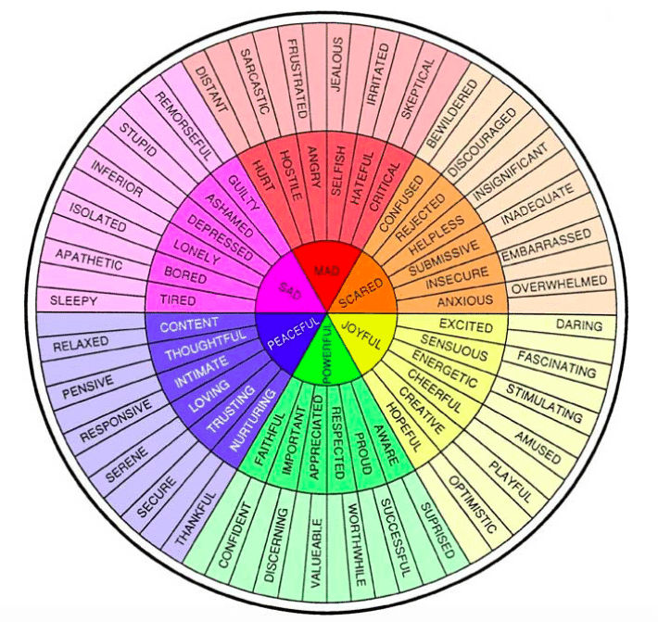

Slide 48
Thoughts
Results
Emotions
Actions

Slide 49
Thoughts and emotions become intertwine
Reaction is so fast we don’t even think about it
We learn practiced, thoughts, feels & behaviors
I’ll be opening up for questions in a few minutes.
You can type them in the chat as we go
Thoughts
Grief Response
Results
Emotions
Actions

Slide 50
Thoughts and emotions become intertwine
Reaction is so fast we don’t even think about it
We learn practiced, thoughts, feels & behaviors
I’ll be opening up for questions in a few minutes.
You can type them in the chat as we go
Thoughts
Grief Response
Results
Emotions
Actions

Slide 51
Thoughts and emotions become intertwine
Reaction is so fast we don’t even think about it
We learn practiced, thoughts, feels & behaviors
I’ll be opening up for questions in a few minutes.
You can type them in the chat as we go
Thoughts
Grief Response
Results
Emotions
Actions

Slide 52
Thoughts and emotions become intertwine
Reaction is so fast we don’t even think about it
We learn practiced, thoughts, feels & behaviors
I’ll be opening up for questions in a few minutes.
You can type them in the chat as we go
Thoughts
Grief Response
Results
Emotions
Actions

Slide 53
Grief Response
Thoughts
Emotions
Actions
Results

Slide 54
Thoughts
Results
Emotions
Actions

Slide 55
Thoughts + Feelings + Actions = State of Being
Improved Thoughts → Improved Feelings → Improved Actions → Improved State of Being

Slide 56
Allowing Emotion
Sit with the feeling and paying attention,
Breathe deeply breath
Go into your body
Ask these questions:
What am I feeling? Name it.
Where do I feel it in my body?
What does the vibration feel like?
Does it have a color, shape or texture?
Sit with the feeling, noticing it, paying attention to it and allowing it to continue to move through you until it’s run its course.

Slide 57
The Emotional Waiting Room

Slide 58
Guilt, Shame & Anger
Guilt: the fact of having committed a specified or implied offense or crime.
Shame: a painful feeling of humiliation or distress caused by the consciousness of wrong or foolish behavior. Dishonor; loss of respect
Anger: a strong feeling of annoyance, displeasure, or hostility.

Slide 59
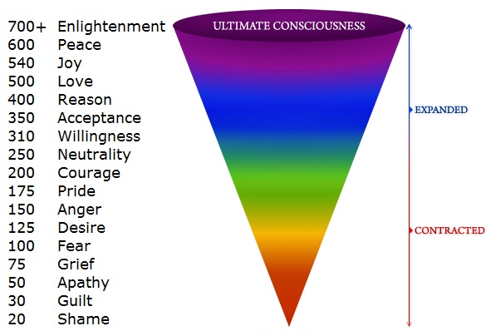
Levels of Consciousness

Slide 60
Guilt vs. Regret
Guilt implies that we intended to cause harm.
Misplaced guilt – no intention to harm
Regret – feeling sad or disappointed that we didn’t take a different action
Unfair to look back with current knowledge and apply it to the past.
We’re always doing the best we can.

Slide 61
Shame
Brene’ Brown: Shame is the intensely painful feeling or experience of believing that we are flawed and therefore unworthy of love and belonging – something we’ve experienced, done, or failed to do makes us unworthy of connection.
This is bad vs. I am bad

Slide 62
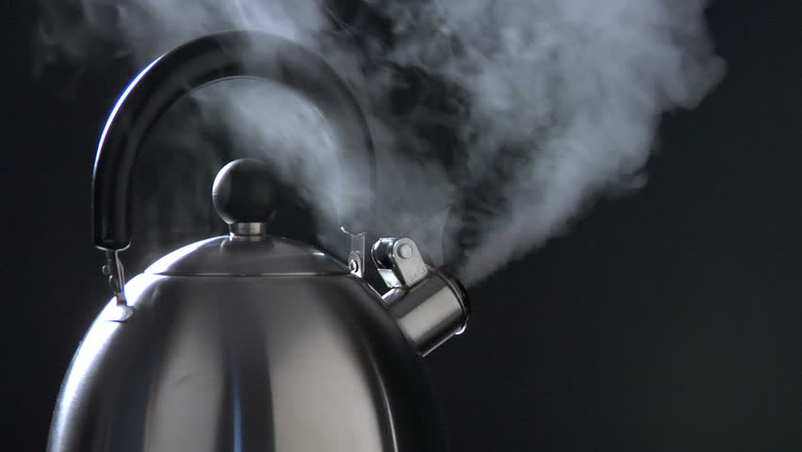

Slide 63
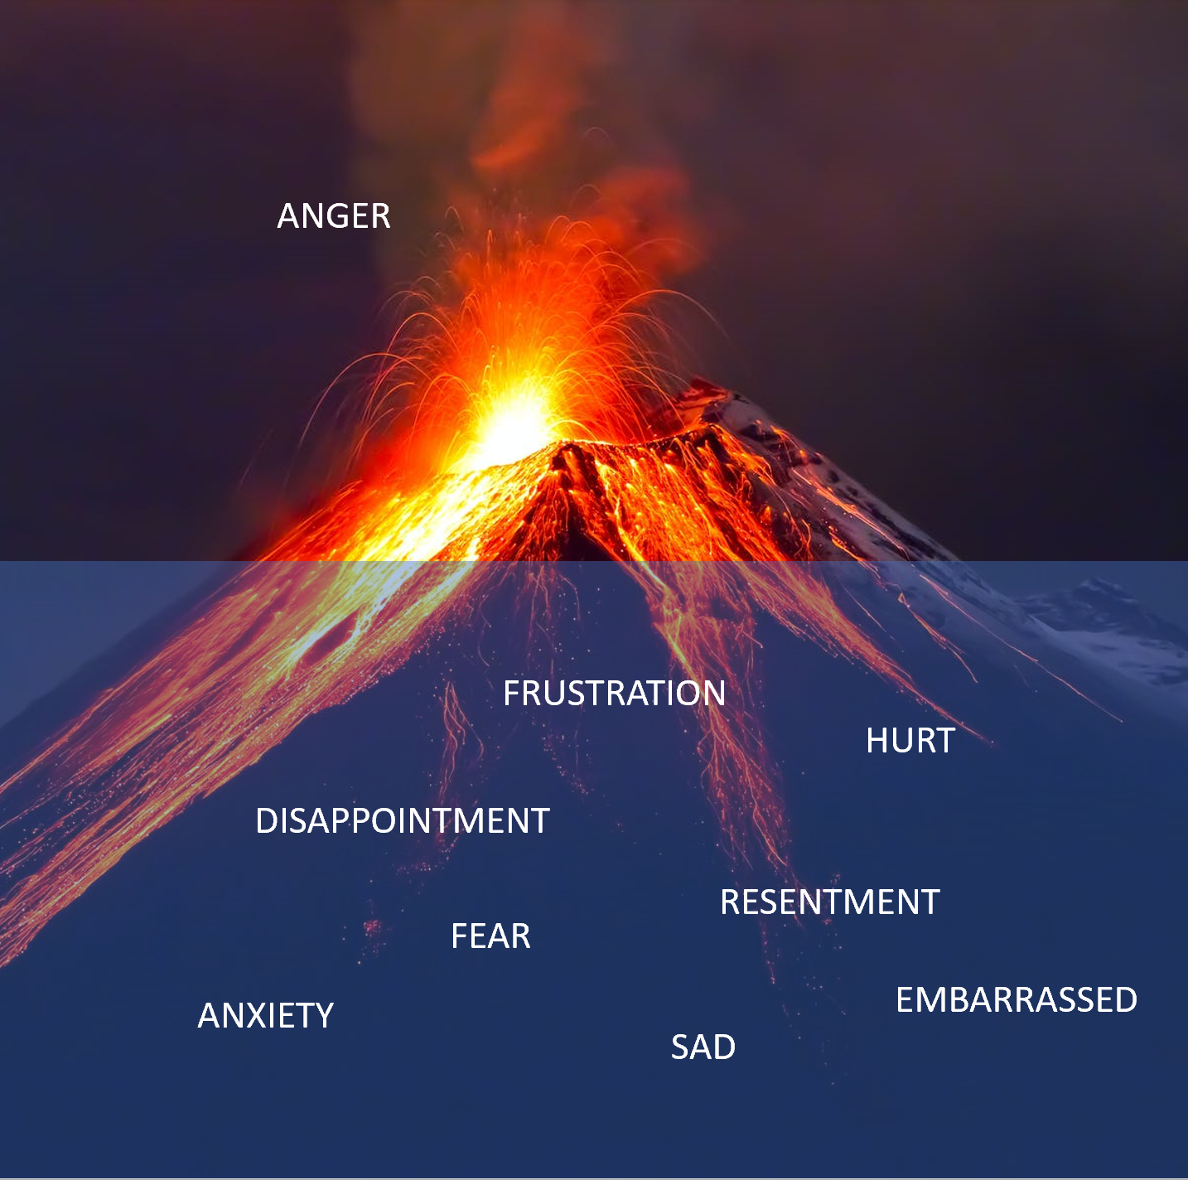

Slide 64
Anger feels more powerful than hurt, pain, sadness or embarrassment.
Expressing anger is a release of the heavy emotion, even though it’s not effective in creating lasting change.

Slide 65
Healing Resistance
Victim Mentality “is a method of avoiding responsibility and criticism and receiving attention and compassion.”

Slide 66
Healing Resistance
Benefits of being the victim:
People will expect less.
Won’t have to put themselves out there.
Reason to stay hidden and not take responsibility for yourself.
Receive attention
Have the right to complain.
Addicted to the drama
Easier to blame and feel the heightened emotions of criticism than to face personal discomfort.

Slide 67
Healing Resistance
If they believe that their love is linked to their pain and their ability to remember, they will be resistant to letting go of the pain.

Slide 68
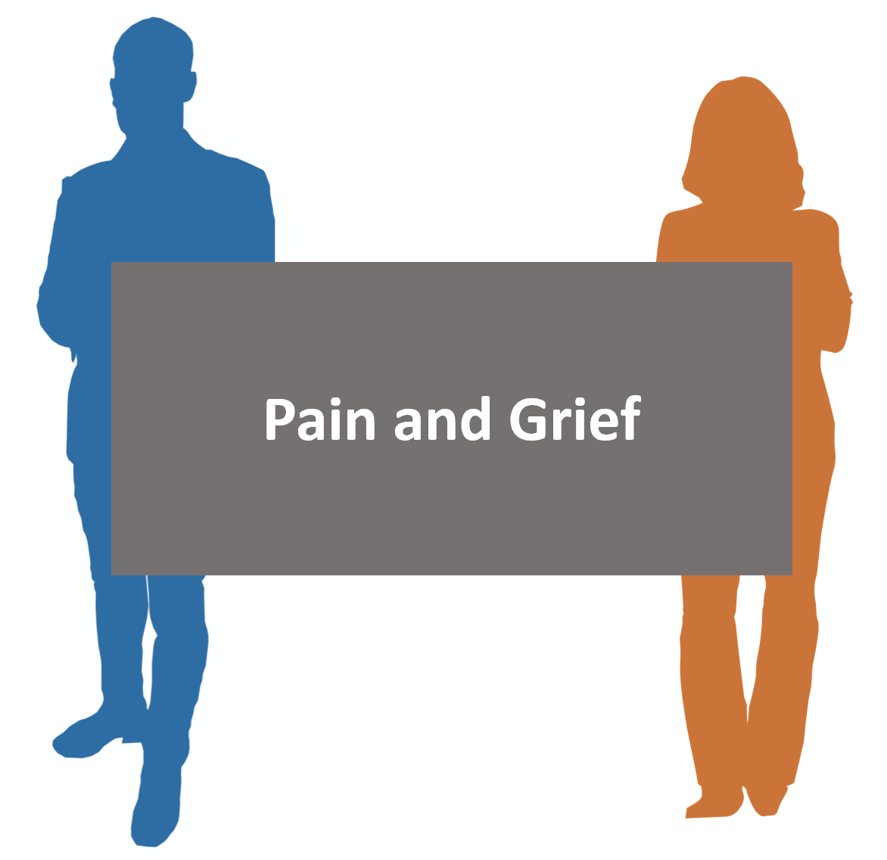

Slide 71
Healing Resistance
When they’ve been wronged, if they believe that letting go of the pain will relieve the other person of responsibility for their wrongs they will resist healing.

Slide 72
Letting Go
Healing is letting go of the pain of loss;
It is not letting go of the person you’ve lost.
You are never moving away from or separating from the person you love; you are only separating from the pain of loss.

Slide 73
Letting Go
Letting go of the grief of the wounds someone else has inflicted on you does not make them less responsible.
You are moving through the pain of the loss and moving toward the life that you want to build while carrying with you the warm memories of those you care about.

Slide 74
Letting Go
“A memory without the emotional charge is called wisdom.” – Dr. Joe Dispenza

Slide 75
Assignments

Slide 76
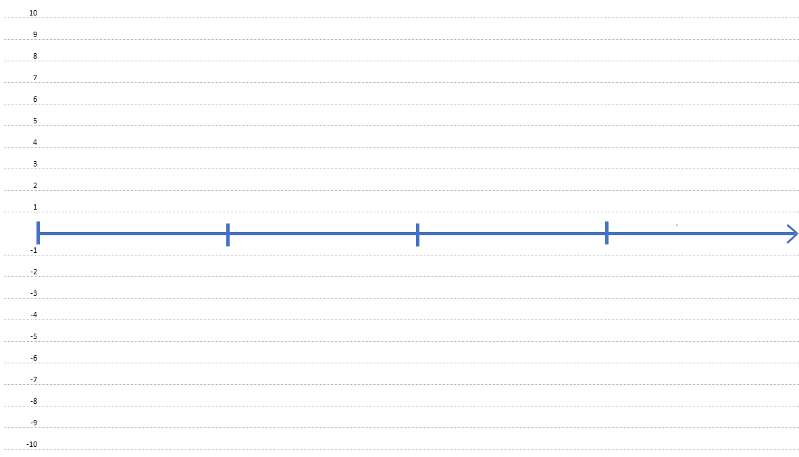

Slide 77
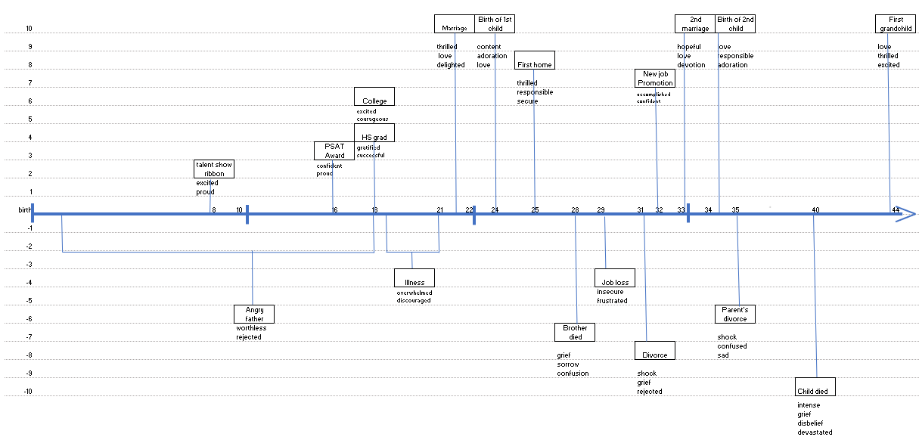

Slide 78
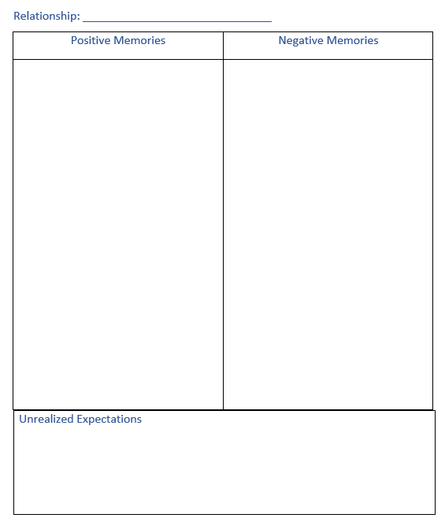

Slide 79
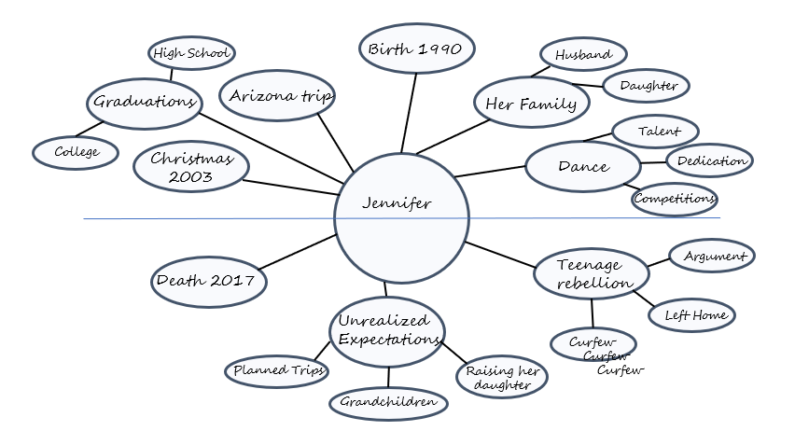

Slide 80
Tips:
There is no ‘right’ way to do this.
Any way you choose to use your timeline is right for you. When you are adding events, you’re comparing the emotional impact of that event against the other experiences of your life not against anything else’s experiences or opinions.
Set an intention that the memories you add to your Timeline or Relationship Memories Graph or Map are the memories that will help you as you heal your grief. Then trust that the stories that come up for you are the ones you needed to remember.
Don’t spend more than 1 hour on this assignment.

Slide 81
Next meeting:
Tuesday, April 12th
Chapters 7
Personal Story Timeline
Relationship Memories Chart or Map

Slide 83
Agenda:
Coaching on coping skills
Increasing awareness
Understanding relationship challenges
Coaching on relationships

Slide 84
Cope
Understand
Discover
Resolve
Rebuild
HOPE Model of Healing
5 Foundations of Growth

Slide 85
Coping Skills
Most people aren’t fully aware of why they are doing the destructive behaviors they are doing
Although most people will have the thought that they shouldn’t be doing it

Slide 86
5 Foundations of Growth: Coping
Numbing
Awareness
Overeating
Overspending
Alcohol/Drugs
Music
Journaling
Walking

Slide 87
Awareness
Always the first step
Will create shifts
Has the potential of creating more shame
Leads to freedom of choice
Choice
Awareness
Unaware

Slide 88
“I should be doing better” Syndrome
Wants to make huge shifts
White knuckling to prove themselves
Forced “healing”
Shame

Slide 89
“I should be doing better” Syndrome
Validate where they are
Validate the way they have chosen to cope up until now
Encourage small steps towards improvement
Shame

Slide 90
With the wall of shame removed or reduced they are encouraged to make incremental progress.
Progress

Slide 91
Encourage self compassion, curiosity and life as an experiment
Progress

Slide 92
Temporary Relief Distractions
Overeating
Over shopping
Overworking
Inappropriate humor
Excessive TV/Movies
Fiction/Fantasy
Isolation
Sex
Oversleeping
Electronics – phone, tablets, computers, etc.
Drugs

Slide 93
Other Temporary Relief Distractions
Blaming

Slide 94
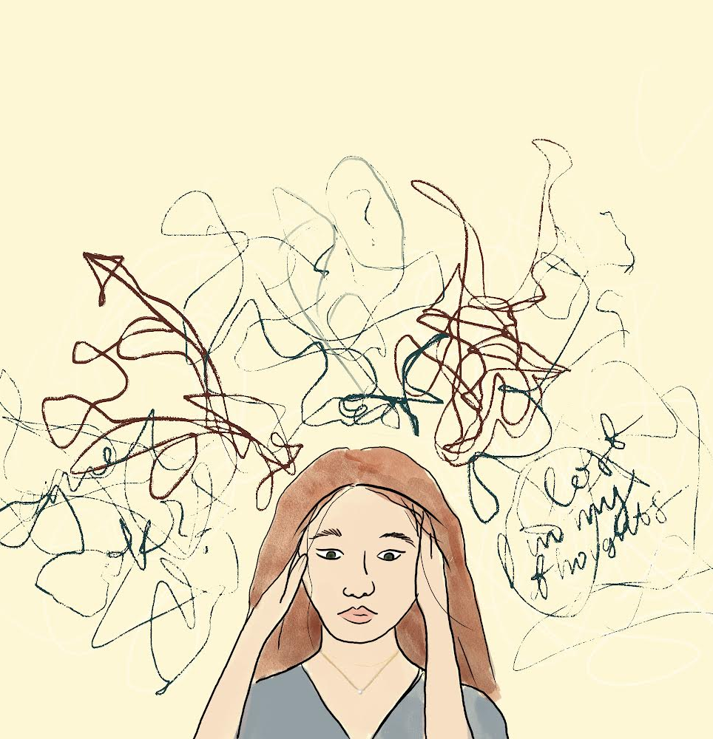
Other Temporary Relief Distractions
Blaming
Ruminating

Slide 95
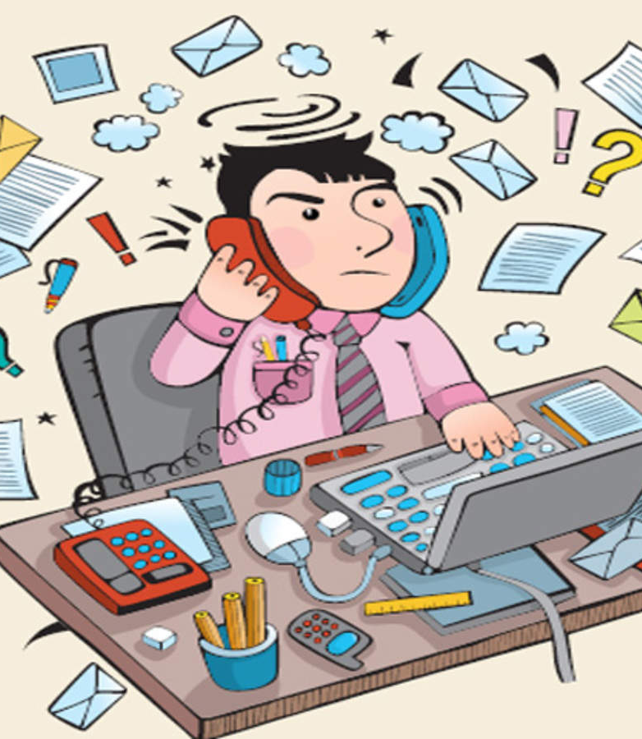
We live in a world with so many distractions that we never have to feel. As a result, awareness is low.

Slide 96
Introducing Temporary Relief
Distractions for what they are creates awareness.
Awareness is not always comfortable.

Slide 97
Healing coping activities
EFT or tapping
Write and rip
Music
Screaming into a pillow
praying
Journal
Draw
Take a class
Enjoy a hobby
What’s good for your body is good for your grief healing
Drink more water
Exercise
Ride a bike
Take a walk
Eat veggies and fruit

Slide 98
Invite them to do healing activities with intention.
Napping can be a good way to heal but if they nap with the thought that they’re not doing it right, they will create more heavy emotion instead of creating healing.
Crying can be an excellent release but if they have heavy judgment about their crying it won’t be as healing.

Slide 99
Improving Coping Skills
Invite them to slowly introduce new activities
Make incremental changes
Remind them that small steps are more sustainable than big leaps
Help them connect to how these changes are benefitting them
Celebrate the small changes with them

Slide 100
5 Foundations of Growth: Coping
Numbing
Awareness
Overeating
Overspending
Alcohol/Drugs
Music
Journaling
Walking

Slide 101
Awareness
Unaware
Awareness
Desire Change
Interrupt Pattern
Create Desired Change

Slide 102
Awareness
Unaware
Awareness
Desire Change
Interrupt Pattern
Create Desired Change

Slide 103
Interrupt Pattern
After
During
Before

Slide 104
Awareness is the first step to meaningful change.
Unaware
Awareness
Desire Change
Interrupt Pattern
Create Desired Change

Slide 105
Accepting your present reality doesn’t mean you endorse it. You may not like what is here but by meeting the truth of this moment with honesty and openness you develop more clarity on how to best move forward. Acceptance is the first step towards wise action. – Cory Muscara

Slide 106
When was the last time you felt this build up in yourself?
Like you were going to explode.
What happened? What triggered it? What were you feeling? What were you thinking?
You can literally learn a process to understand your triggers that will lead to disarming the trigger.
Relationship Challenges

Slide 107
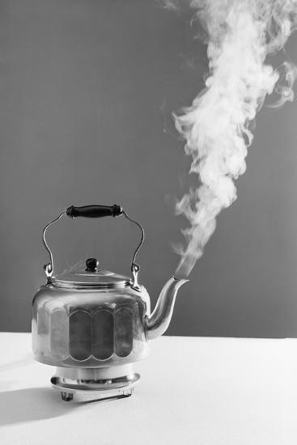
Thought Trigger
Image Trigger
Word Trigger

Slide 108
Thought Trigger
Image Trigger
Unaware
Word Trigger

Slide 109
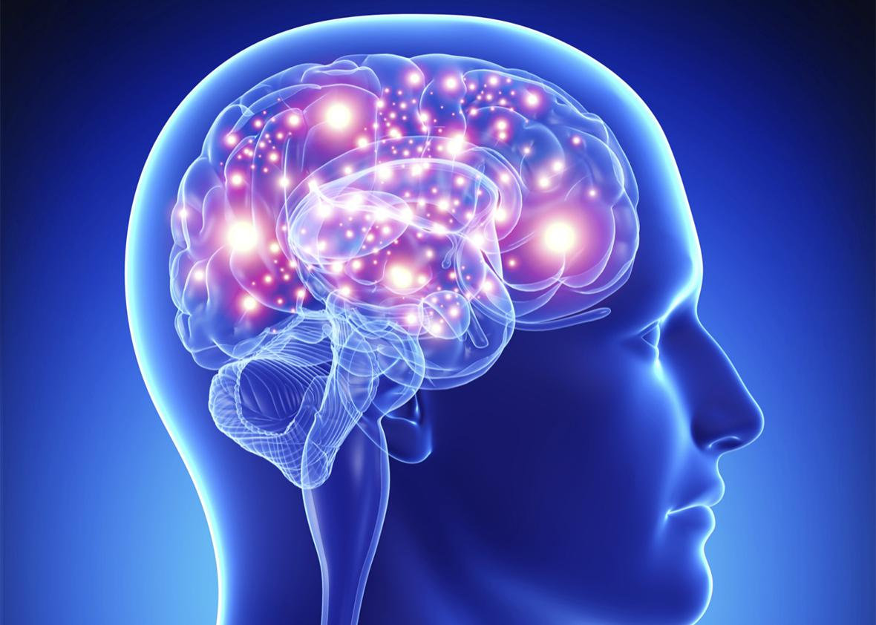
Our mind and our heart matter, in our grieving process

Slide 110
Thoughts
Relationships exist in our thoughts.
Results
Emotions
Actions

Slide 111
In grief:
Thoughts and emotions become intertwined.
Reactions are so immediate they don’t even think about it.
They learn practiced thoughts, feelings & behaviors.
Thoughts
Emotions
Actions
Results

Slide 112
Thoughts and emotions become intertwine
Reaction is so fast we don’t even think about it
We learn practiced, thoughts, feels & behaviors
I’ll be opening up for questions in a few minutes.
You can type them in the chat as we go
Thoughts
Thoughts and emotions become intertwine
Reaction is so fast we don’t even think about it
They learn practiced, thoughts, feels & behaviors
Grief Response
Results
Emotions
Actions

Slide 113
“Between stimulus and response there is a space. In that space is our power to choose our response. In our response lies our growth and our freedom.” – Viktor Frankl
As their coach, you create the space for them to see things differently, change their thinking and change their emotions, which changes their actions and results.
Stimulus:
Thought:
Emotion:
Action:
Result:

Slide 114
As their coach, you create the space for them to see things differently, change their thinking and change their emotions, which changes their actions and results.
Stimulus: friend didn’t call
Thought: no one cares about me
Emotion: lonely, abandoned, unloved
Action: feel sorry for yourself, isolate
Result: live isolated, depressed and lonely

Slide 115
As their coach, you create the space for them to see things differently, change their thinking and change their emotions, which changes their actions and results.
Stimulus: friend didn’t call
Thought: no one cares about me
Emotion: lonely, abandoned, unloved
Action: feel sorry for yourself, isolate
Result: live isolated, depressed and lonely
This thought is a grief response

Slide 116
As their coach, you create the space for them to see things differently, change their thinking and change their emotions, which changes their actions and results.
Stimulus: friend didn’t call
Thought: no one cares about me
Emotion: lonely, abandoned, unloved
Action: feel sorry for yourself, isolate
Result: live isolated, depressed and lonely
What else could be true?

Slide 117
As their coach, you create the space for them to see things differently, change their thinking and change their emotions, which changes their actions and results.
Stimulus: friend didn’t call
Thought: I love her, and I want to stay
connected.
Emotion: love, thankful, connected
Action: call your friend, stay connected, create bond
Result: friendship and connection
What else could be true?

Slide 118
Next meeting:
Tuesday, April 5th
Chapters 6

Slide 119
Brain
heart
Brain
heart
Past
Future

Slide 120
Brain
heart
Brain
heart
Past
Future

Slide 121
Past
Future

Slide 122
“A memory without the emotional charge is called wisdom.”
– Dr. Joe Dispenza
Past
Future

Slide 124
Agenda
3 prerequisites: Desire, Hope and Effort
The Hope Model of Healing
Transcending the Levels of Consciousness
Post-traumatic growth
Understanding relationship challenges

Slide 125
Desire
Results
Behavior

Slide 126
Blocks to Desire
Lack of Hope; Despair
Rewards of Grieving
Learned Hopelessness

Slide 127
3 Aspects of Motivation
Clear and compelling goal
A path to get there
Confidence that they can actually do it

Slide 128
Hope
Hope
Influenced by their thoughts
Influenced by what they consume
Influenced by what others are saying
Help them see how their choices influence their results
Help them choose what they think, what they consume and what they believe
Despair

Slide 129
Effort
"If time actually healed people, no one in the world would be hurting. Time is simply space. What matters is how you use it. If you fill your time intentionally with self-love, letting go, and building the new habits your being needs, that would make a real difference" -Yung Pueblo
Understanding and applying the steps of healing gives people their power back. Then they experience fruitful effort.

Slide 130
Cope
Understand
Discover
Resolve
Rebuild
HOPE Model of Healing
5 Foundations of Growth

Slide 131
Cope
Understand
Discover
Resolve
Rebuild
HOPE Model of Healing
5 Foundations of Growth

Slide 132
Cope
Understand
Discover
Resolve
Rebuild
HOPE Model of Healing
5 Foundations of Growth

Slide 134
Grief
This is the level of sadness, loss and despondency. Most people have experienced it for periods of time, but those who remain at this level live a life of constant regret and depression.
This is the level of mourning, bereavement and remorse about the past.
Major losses in early life make one later vulnerable to passive acceptance of grief, as though sorrow were the price of life.
This level colors one’s entire vision of existence. Part of the syndrome of loss is the sense of inability to replace what is lost or what is symbolized.

Slide 135
Clinical
The universality of the experience is due to the structure and nature of the ego, which misperceives the source of happiness as external or emotional and imbues it with specialness. In reality, the only source of happiness is from within.
The spiritually evolved person who has few wants or attachments is relatively immune to grief, as the experience of the source of happiness originates from within and is not dependent on externals.
Happiness is the inner psychological reward for achievement of externalized goals as a self-reward system, and the error is to think that the source of happiness is due to the ‘out there’ instead of originating from within.
The externalization of perceived sources of happiness leads to attachments and the emergence of control as a major survival mechanism, along with the desire for status and its symbols of security, and therefore, materialism.

Slide 136
Spiritual Orientation
Not uncommonly, major loss results in turning to religion or spirituality for help and answers. Loss therefore provides an opportunity for increased intention to reevaluate spiritual principles and put them into actual practice rather than just intellectual appreciation.
It is well to know that spiritual research indicates that all suffering and emotional pain result from resistance. Its cure is via surrender and acceptance, which relieve the pain.
Pain of loss is not steady or continuous but comes in waves that can be diminished by consistent nonresistance and surrendering continuously to God.
Paradoxically, loss is simultaneously freedom and opening of new options. Loss services inner adaptations and qualities that represent opportunities for growth.
All aspects of human life are transient; therefore, to cling to any aspect eventually brings grief and loss.
Grief and loss, like any stressful situation in life, can be seen as a valuable growth opportunity and a time for reassessment of values and goals.

Slide 137
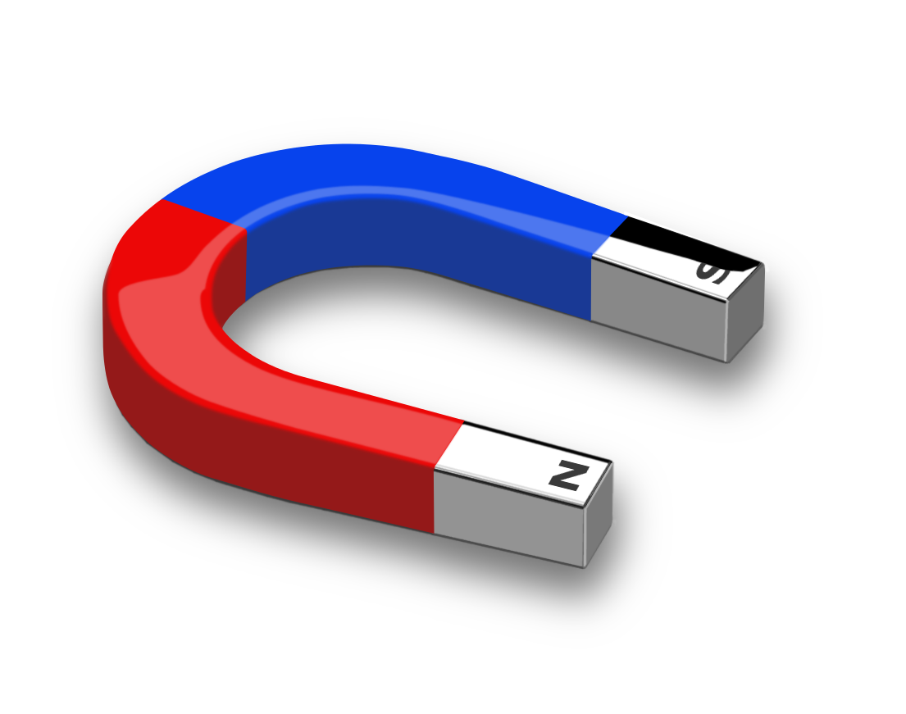
Dualities of Grief
Attraction Aversion
Cling to → Let go of
Live in the past → Live in the now
Undo → Accept
Bargain with God → Accept limitation
Deny → Work through
Anger, resentment → Acceptance
Resist → Transcend
Despondency → Hope
Go back in time → Move forward
Life full of problems → Life full of solutions
Bitter → Faith and hope

Slide 138
Post-traumatic Growth
Attraction Aversion
Cling to → Let go of
Live in the past → Live in the now
Undo → Accept
Bargain with God → Accept limitation
Deny → Work through
Anger, resentment → Acceptance
Resist → Transcend
Despondency → Hope
Go back in time → Move forward
Life full of problems → Life full of solutions
Bitter → Faith and hope

Slide 139
“Post-traumatic growth describes the positive life changes that develop through a stressful, frightening experience.
“Researchers note that post-traumatic growth is not the same as resilience. Resilience describes people returning to their previous levels of functioning. Meanwhile, post-traumatic growth refers to positive personal change.
“Studies show that after a traumatic event, reports of personal growth are more common than those of psychiatric disorders.”
(cancer.net)

Slide 140
It’s comforting to know that post traumatic growth is much more likely than posttraumatic stress. In an article by Lorna Collier for the American Psychological Association she wrote:
“Post-traumatic growth (PTG) is a theory that explains this kind of transformation following trauma. It was developed by psychologists Richard Tedeschi, PhD, and Lawrence Calhoun, PhD, in the mid-1990s, and holds that people who endure psychological struggle following adversity can often see positive growth afterward.’
“People develop new understandings of themselves, the world they live in, how to relate to other people, the kind of future they might have and a better understanding of how to live life,’ says Tedeschi.”

Slide 141
Growth developed after loss:
new understandings of themselves
new understandings of the world they live in
how to relate to other people
the kind of future they might have
better understanding of how to live life

Slide 142
Next meeting:
Tuesday, March 22nd
Chapters 5

Slide 144
Agenda:
Healing vs. Despair
Levels of Grief
Grief/Trauma Response
Capacity during Grief
Restorative Self Care

Slide 145
Healing
Peace
Joy
Love
Grief is a normal response to loss. It also places someone at the crossroad between despair and healing.
Grief is intended to support healing but it’s dangerously close to despair.
Grief is a season.
Courage
The choices made regarding thoughts, feelings and actions, while in grief, matter.
Courage is on the path to healing.
Grief
Guilt
Fear
Shame
Despair

Slide 146
Your Grief

Slide 147
Model of Grief

Slide 148
Model of Grief
Hidden Grief
Prolonged Anger
Victim Mentality
Hopelessness

Slide 149
Hidden or Unresolved Grief
Grief
Happiness
Goals & Desires

Slide 150
Level 1: Resolved Grief
Behaviors:
Hobbies/Interests
Self Care
Comfortable Talking about Your Loss
Social
Build Relationships
Live a Full Life with a Full Range of Emotions
Common Emotions:
Happiness
Purpose
Occasional sadness

Slide 152
Thoughts and emotions become intertwine
Reaction is so fast we don’t even think about it
We learn practiced, thoughts, feels & behaviors
I’ll be opening up for questions in a few minutes.
You can type them in the chat as we go
Thoughts
Results
Emotions
Actions

Slide 153
Thoughts and emotions become intertwine
Reaction is so fast we don’t even think about it
We learn practiced, thoughts, feels & behaviors
I’ll be opening up for questions in a few minutes.
You can type them in the chat as we go
Thoughts
Grief Response
Results
Emotions
Actions

Slide 154
Thoughts and emotions become intertwine
Reaction is so fast we don’t even think about it
We learn practiced, thoughts, feels & behaviors
I’ll be opening up for questions in a few minutes.
You can type them in the chat as we go
Thoughts
Grief Response
Results
Emotions
Actions

Slide 155
Thoughts and emotions become intertwine
Reaction is so fast we don’t even think about it
We learn practiced, thoughts, feels & behaviors
I’ll be opening up for questions in a few minutes.
You can type them in the chat as we go
Thoughts
Grief Response
Results
Emotions
Actions

Slide 156
Thoughts and emotions become intertwine
Reaction is so fast we don’t even think about it
We learn practiced, thoughts, feels & behaviors
I’ll be opening up for questions in a few minutes.
You can type them in the chat as we go
Thoughts
Grief Response
Results
Emotions
Actions

Slide 157
Trauma:
A deeply distressing or disturbing experience
physical injury.

Slide 158
Expanded definition:
Trauma is anything that causes someone to feel less than, small, unworthy or unlovable.

Slide 159
When someone practices thoughts that they’re not good enough, less than or aren’t lovable, they suppress their life force energy and their ability to heal.

Slide 160
Unhealed trauma/grief can cause someone to not live out the true expression of who they are.
Labels and statistics may be holding them back.
Trauma

Slide 161
The Grief Recovery Handbook…
-defines trauma as ongoing mistreatment or abuse that a person may experience
-or the impact of a singular event
-suggests that labeling losses as Trauma and PTSD moves you away from recovery.

Slide 162
Identifying the loss so that it can be worked on moves them toward healing.
What is the loss?
Loss of trust
Loss of safety
Loss of control
Loss of value
Trauma

Slide 163
Capacity
Grief

Slide 164
The problem isn’t grief.
Grief is the solution.
The problem is the misunderstanding and judgment of grief.

Slide 166
Capacity
Grief:
Guilt
Fear
Shame
Etc.

Slide 167
Capacity
Fear
Shame
Guilt
Grief

Slide 168
Capacity
Fear
Shame
Guilt
Grief

Slide 169
Restorative Self Care
Restorative - having the ability to restore health, strength, or a feeling of well-being
Restorative self care is care for the self that has the ability to restore (repair) health, strength and a feeling of well-being

Slide 170
Guilt
Shame
Fear
Sadness
Pain
Grief

Slide 171
Love
Compassion
Gratitude
Restorative
Process
Sadness
Pain
Grief

Slide 172
Feeling
Walking
Nature
Breathing
Meditation
Uplifting Music
Journaling
Restorative
Process
Accept your emotions/energy
Do the things you enjoy
Create a compassionate inner dialog
Allow emotions
Breathe
Advocate for yourself
Take breaks when you need to
Overeating
Overdrinking
Netflix Binging
Social Media
Over shopping
Over sleeping
Anger

Slide 173
Restorative Self Care
Through a regular practice of releasing heavy emotion and inputting the good, with time and effort, capacity can be restored and even expanded.
They can exercise their power of personal choice by choosing the daily practice of releasing emotion.
In this way they gently take responsibility for their experience.
Capacity
Fear
Shame
Guilt
Grief

Slide 174
Restorative Self Care
Through a regular practice of releasing heavy emotion and inputting the good, with time and effort, capacity can be restored and even expanded.
They can exercise their power of personal choice by choosing the daily practice of releasing emotion.
In this way they gently take responsibility for their experience.
Over time and as they work through the Hope Model of Healing, they’ll start to feel relief from grief.
Because we’re human we will always experience a range of emotions.
Capacity
Fear
Shame
Guilt
Grief

Slide 175
Restorative Self Care
Through a regular practice of releasing heavy emotion and inputting the good, with time and effort, capacity can be restored and even expanded.
They can exercise their power of personal choice by choosing the daily practice of releasing emotion.
In this way they gently take responsibility for their experience.
Over time and as you work through the Hope Model of Healing, you’ll start to feel relief from grief.
Because you’re human you will always experience a range of emotions.
Yet having released heavy grief they can restore their capacity again.
Regardless of their capacity they are always whole and worthy.
Over time and as they work through the Hope Model of Healing, they’ll start to feel relief from grief.
Because we’re human we will always experience a range of emotions.
Capacity

Slide 176
Next meeting:
Tuesday, March 8th
Chapters 3 & 4

Slide 179
Goal:
to become…
Comfortable
Confident
Effective
in supporting a client in their grief and assisting them in incremental healing steps and shifts.

Slide 180
What is loss?
death, divorce, ill health, relationship
difficulty, break up, miscarriage,
still birth, pet loss, financial loss, estrangement, abuse, etc.
All loss causes feelings of grief.

Slide 181
What is Grief?
Traditional definition: deep sorrow,
especially that caused by someone’s
death.

Slide 182
What is Grief?
Expanded definition:
The unrelenting painful feelings caused by emotional injury or loss of any kind. The painful feelings of loss of a desired future or outcome.

Slide 183
What is Healing?
The release of unrelenting painful feelings.
Experiencing feelings of purpose, happiness and enthusiasm for life.
Feeling occasional sadness about your loss.
Being comfortable talking about your loss.
Living a full life with a full range of emotions.

Slide 184
Coaching Package
12 appointments
1st appointment: Assessment
Grief
Confidence
Relationships
Health
Purpose
Each appointment review a new chapter/assignment

Slide 185
Weekly Appointment
What Went Well this Week? (WWW)
Anchor in WWW
What Didn’t Go Well? (WDW)
Find the lessons in the WDW
What stood out in your reading?
Discover what is important to them and what is shifting
What questions do you have?
Discover where they are struggling
What are you ready to shift?
Find their concerns
What are your take aways
Anchor in the things they learned
Use Session Prep Form

Slide 186
The Power of a Good Question
Use for Discovery
Expand Understanding
Create Space for Shifts

Slide 187
The Power of a Good Question
What?
What happened?
What did you think? Feel? Do?
When?
Where?
How?
How did you feel?
How did you respond?

Slide 188
The Power of a Good Question
Why?
Use sparingly
Why did you choose to think/feel that? Why do you think/feel this happened/ she did this?
What if?
What if it’s ok to be sad?
What if it’s possible to allow this?
What if you could let go of carrying this heavy burden?

Slide 189
Growing Around Grief

Slide 190
HOPE Model of Healing
When we have the strength to carry the grief, we have the strength to heal.

Slide 191
Grief
Healing

Slide 192
Have you experienced the heavy pull of grief?
Cope
Rebuild

Slide 193
Grief
Healing

Slide 194
Grief
Healing
Vision

Slide 195
Grief
Healing

Slide 196
HOPE Model of Healing
5 Foundations of Growth
REBUILDING
RESOLVING
DISCOVERING
UNDERSTANDING
COPING

Slide 197
The problem isn’t grief.
Grief is the solution.
The problem is the misunderstanding and judgment of grief.

Slide 198
Week 2 Assignments:
Read, study chapter 2
Answer the questions in the workbook

Slide 200
Grief is uncomfortable
Fear because you don’t know what to do
Feel helpless
Feel like you must fix it
Panic because you don’t understand grief
Anxious to talk people out of it
Goal: to become comfortable, confident and effective in supporting a client in their grief and assisting them in incremental steps and shifts.

Slide 201
“Nothing good has come from the death of my daughter, but good has come from my response to it.”
-Sandy

Slide 202
Why I’m Able to Do This Work
Because I know in my bones that healing is possible
Because I have felt the affects of grief healing and I’m encouraged to share that with others
Because if a person is willing to put in the effort, learn and grow they will experience healing

Slide 203
“The pain that you create now is always some form of nonacceptance, some form of unconscious resistance to what is.
“On the level of thought, the resistance is some form of judgment.
“On the emotional level, it is some form of negativity.
“The intensity of the pain depends on the degree of resistance to the present moment, and this in turn depends on how strongly you are identified with your mind.”
–Eckhart Tolle, The Power of Now, pg. 33

Slide 204
Levels of Consciousness

Slide 205
Common physical, emotional and social grief symptoms:
Crying
Headaches
Interruption in Sleep Patterns
Questioning the Purpose of Life
Questioning Your Spiritual/Religious Beliefs
Feelings of Detachment
Isolation from Friends and Family
Abnormal Behavior
Abnormal Thoughts
Worry
Anxiety
Frustration
Guilt
Fatigue
Anger
Change in Appetite
Aches and Pains
Stress

Slide 206
Common treatments:
Counseling
Medication
Support groups
Common attitudes:
Time Heals
Learn to Live With It

Slide 207
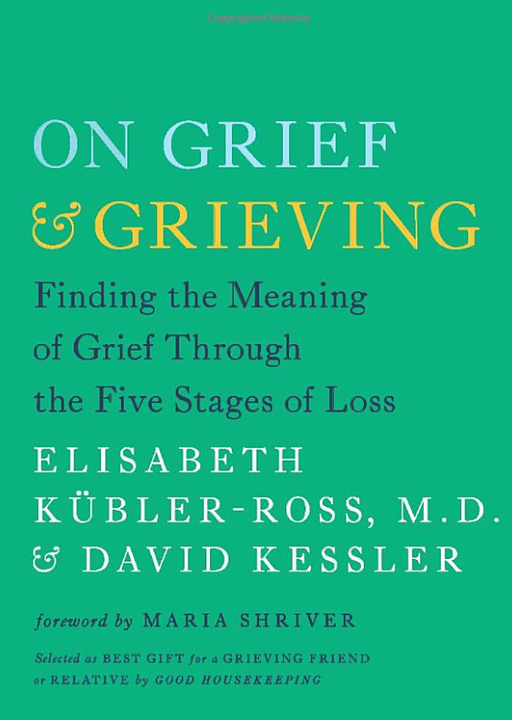
The History of Grief Education
1969 Dr. Elisabeth Kubler-Ross – 5 Stages of Grief, On Death and Dying
2005 Dr. Kubler-Ross with David Kessler, On Grief and Grieving
1996 Dr. Lois Tonkin Model of Grief

Slide 208
The History of Grief Education
“Limited literature on grief”
“I’ve never heard this before and I’m a social worker. I am filled with so much hope. People need to know about this.”

Slide 209
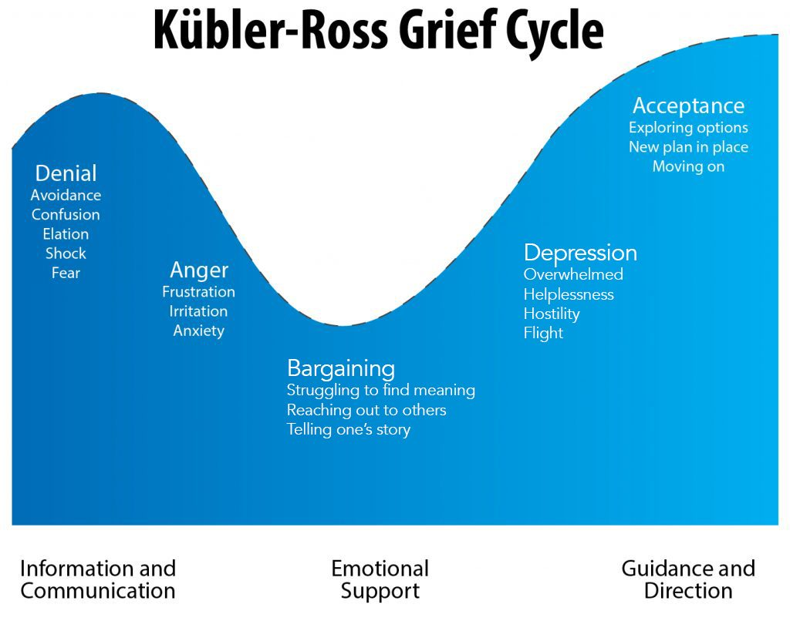

Slide 210
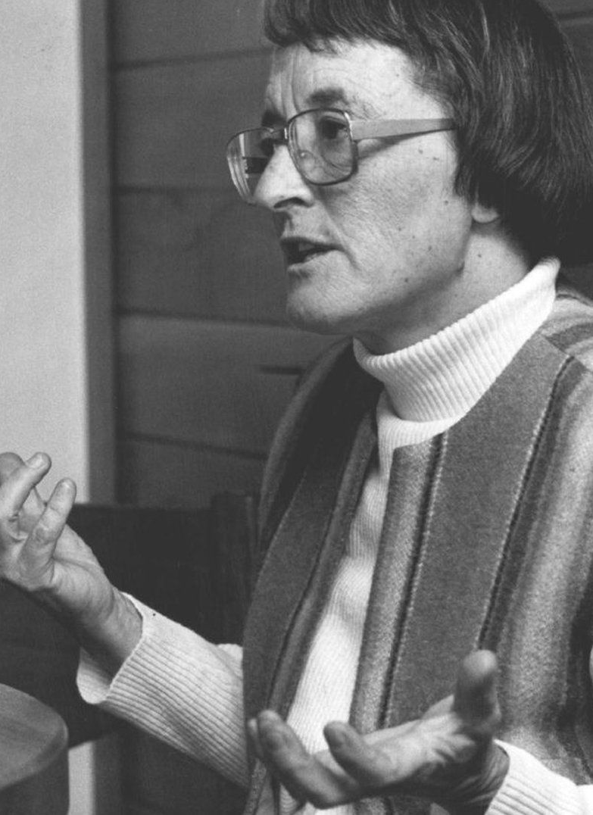
5 Stages of Grief
Denial, Anger, Bargaining, Depression and Acceptance
Developed by Dr. Elisabeth Kübler-Ross
Explains common emotional responses
Not linear as ‘stages’ suggest
Incomplete and doesn’t offer a pathway

Slide 211
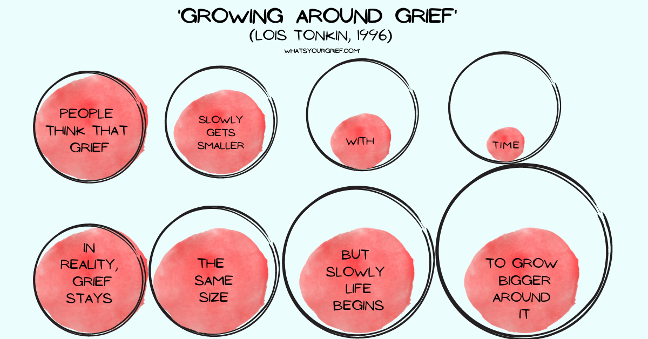
Model of Grief

Slide 212
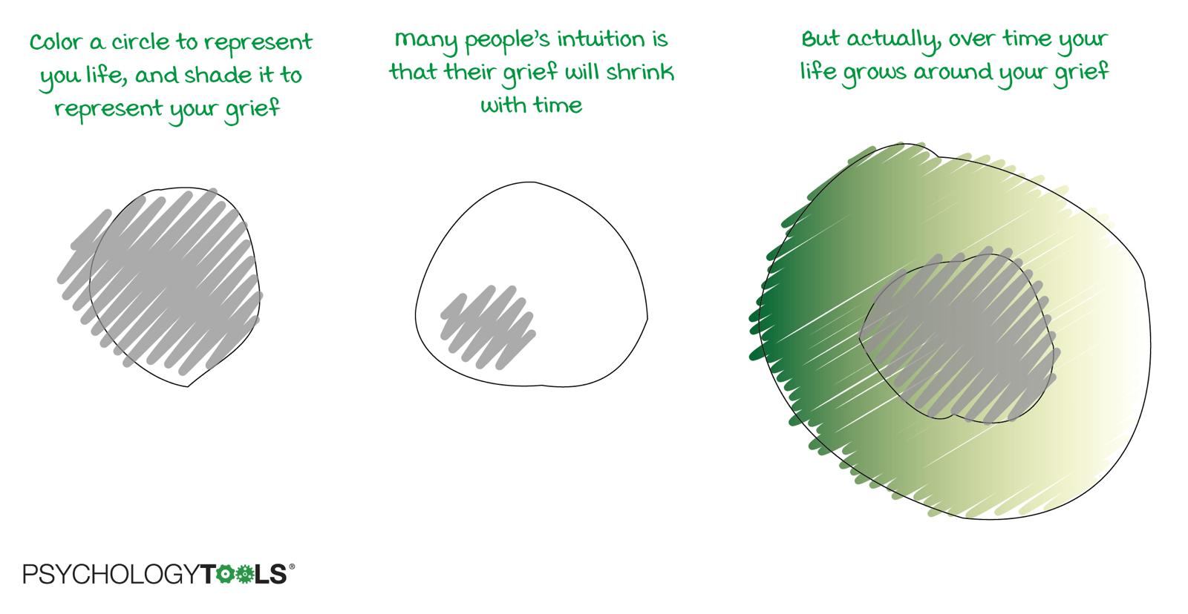
Model of Grief

Slide 213
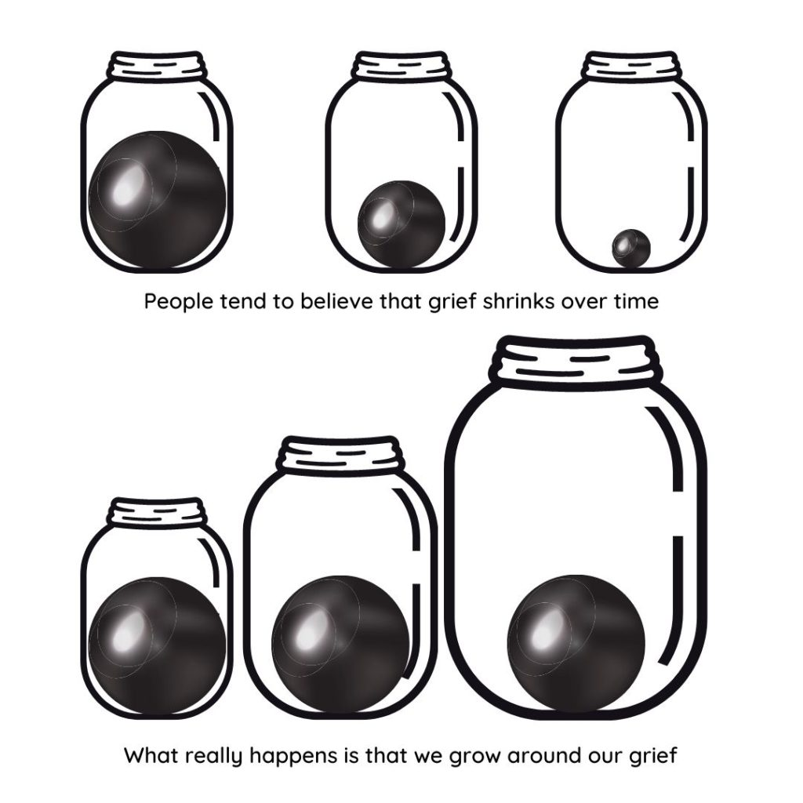
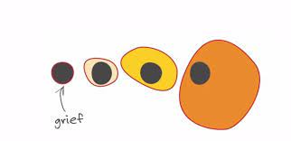
Model of Grief

Slide 214
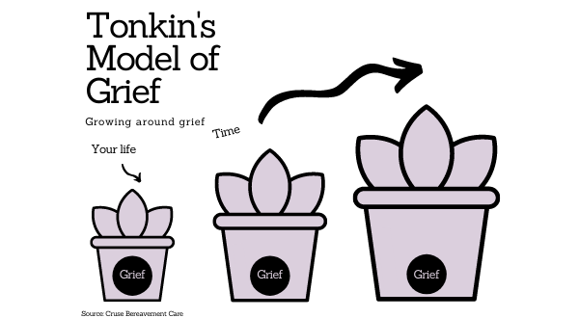
Model of Grief
https://fb.watch/b2xJ8GT8E7/

Slide 215
Model of Grief

Slide 216
HOPE Model of Healing
When we have the strength to carry the grief, we have the strength to heal.

Slide 217
HOPE Model of Healing
Honor Your Grief
Open to Understanding
Prepare through Discovery
Embrace Resolution and Rebuilding
HOPE offers a pathway to healing
and leads to transformation
©JULIE CLUFF buildalifeafterloss.com

Slide 218
Brain
heart
Past
Future

Slide 219
feelings and emotions are a record of the past
those feelings are driving your hardwired thoughts and behaviors…
-Dr. Joe Dispensa
Past
Future

Slide 220
Past
Future

Slide 221
Past
Future

Slide 222
Listen for shame.
“I should be doing better” is identity shame.
Shame says, “I am bad.”
Shame is a lower vibration than grief and blocks healing.
Shame

Slide 223
Lies make us weak.
The truth makes us stronger.
Gently direct client to truth.
Shame

Slide 224
Encourage empowering thoughts and gentle progress.
The truth is they are right where they are supposed to be.
The truth is they hurt and that’s ok.
The truth is the power to do is the power to change.
The truth is they can make progress.
The truth is progress is progress.
Progress

Slide 225
Do not underestimate the power of new thoughts/knowledge.
Do not underestimate the power of expression.
Progress

Slide 227
Post-traumatic Growth
A positive psychological change experienced as a result of adversity and other challenges in order to rise to a higher level of functioning.
Posttraumatic growth involves "life-changing" psychological shifts in thinking and relating to the world, that contribute to a personal process of change, that is deeply meaningful.

Slide 228
Week 1 Assignments:
Read intro and chapter 1
Underline things that stand out to you. Make note of any questions
Answer the questions in the workbook
On page 4 underline or list what I had to learn/shift to heal
Log into the True Hope Club
Listen to any of the webinars or podcast episodes you’re interested in

